Slide 1
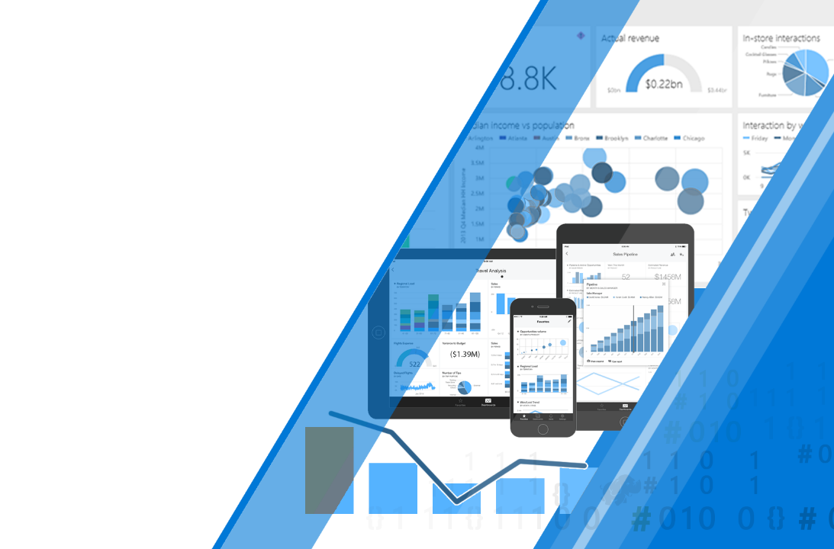
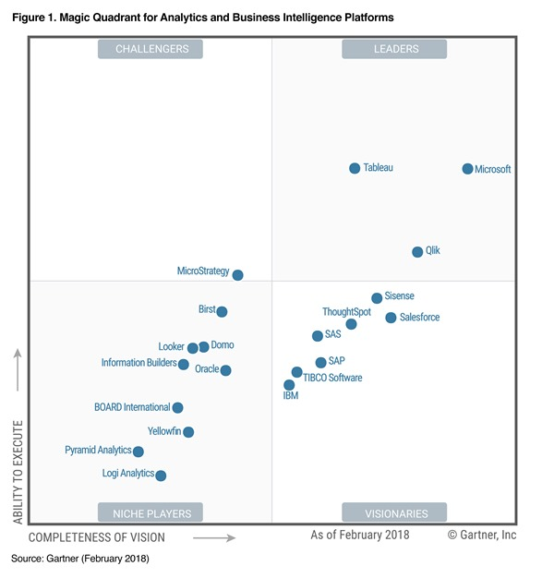
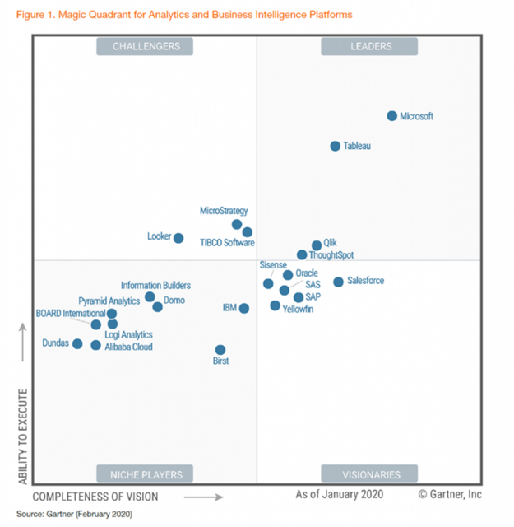
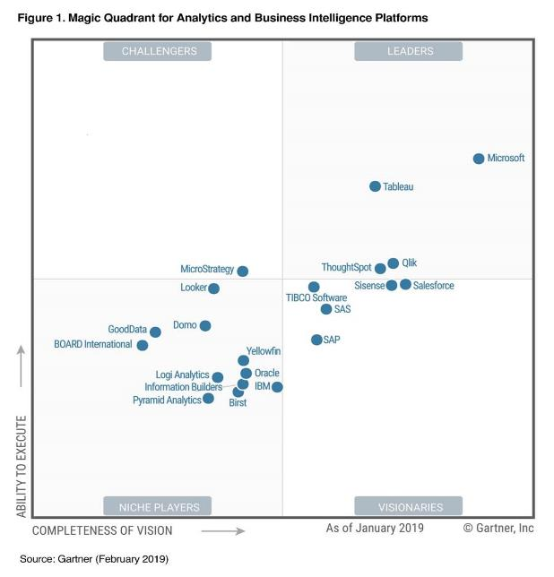
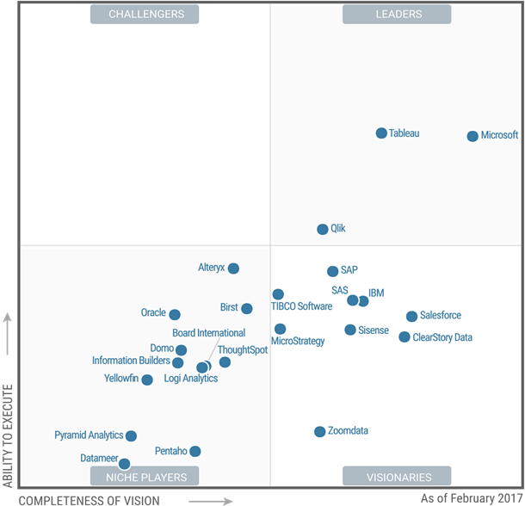
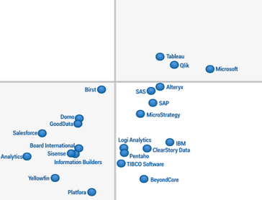
Microsoft Power BI
Enterprise Deployment Workshop
Gartner Magic Quadrant for Business Intelligence & Analytics Platforms, February 2016
Tyler Chessman (tylerc@Microsoft.com)
Last Saved: Oct 2020
*https://aka.ms/gartnerbimq2020
Notes:
**This graphic was published by Gartner, Inc. as part of a larger research document and should be evaluated in the context of the entire document. The Gartner document is available upon request from Microsoft. Gartner does not endorse any vendor, product or service depicted in its research publications, and does not advise technology users to select only those vendors with the highest ratings or other designation. Gartner research publications consist of the opinions of Gartner’s research organization and should not be construed as statements of fact. Gartner disclaims all warranties, expressed or implied, with respect to this research, including any warranties of merchantability or fitness for a particular purpose.
- https://powerbi.microsoft.com/en-us/blog/gartner-recognizes-microsoft-as-a-leader-in-analytics-and-bi-platforms-for-11-consecutive-years/

Slide 2
Agenda
Introductions and Expectations for the Day
Architectural Overview of Power BI
Roles/Responsibilities
Provisioning of Services, Users, & Software
Training and Evangelism
Managing/Exposing Data Sources
Publishing and Sharing Content - Best Practices
Supporting Data Refresh and Live Connections
Security Best Practices
Monitoring and Auditing activity

Slide 3
Notes
This material was originally developed in 2017
It is intended to be delivered as a 1-day workshop (instructor led – with demos, no formal hands-on activities)
I periodically maintain/refresh this material – please check the GitHub repository for updates, https://github.com/tylerchessman/PBIEnterpriseDeploymentWorkshop
Additional resources are also available, including
Planning a Power BI Enterprise Deployment
Power BI Premium Planning and Deployment
Please refer to the Power BI Whitepapers web-page: https://docs.microsoft.com/en-us/power-bi/guidance/whitepapers
There is also a comprehensive Power BI Adoption Framework that includes a series of PowerPoint decks and videos
https://github.com/pbiaf

Slide 4
Azure Data Services Overview
GATHER
STORE
MODEL
ANALYZE
SHARE
ETL
RDW
Reporting
Portal
SSIS
OLAP
SSRS
SharePoint
SQL Svr
Power BI Report Builder
Power BI Service / Premium
Data Factory
Synapse Analytics
Traditional Apps (structured)
SSAS
Data Lake
Schema on Write
Ad-hoc
Custom Apps
Data Lake Gen2 Storage
Analysis Services
Excel
Schema on Read
Hadoop
Power BI Desktop
Power BI Embedded
Media (unstructured)
Databricks
HD Insight
Synapse
Files (unstructured)
Cold Path
Event Ingress
CEP
ML/AI
IoT Edge
Event Hub
IoT Hub
Stream Analytics
Cosmos DB
ADX / TSI
ML Services Cognitive Services
Logs (unstructured)
Hot Path
Power BI,
Azure Functions
Etc.
Inventory Assess & Govern Discover & Enrich
Azure Data Catalog Gen 2 (Babylon)

Slide 5

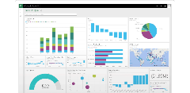


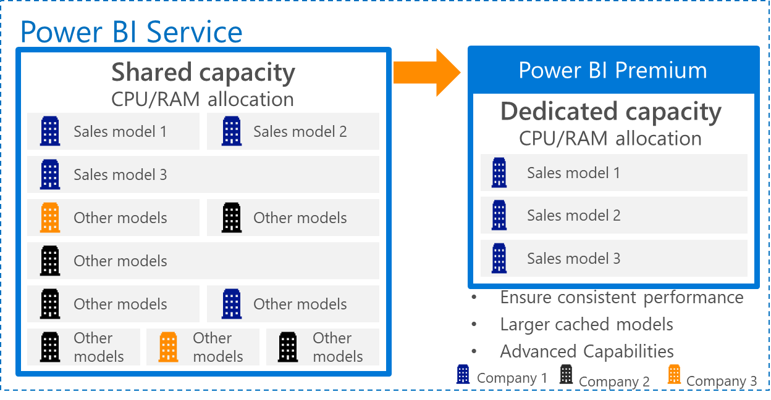
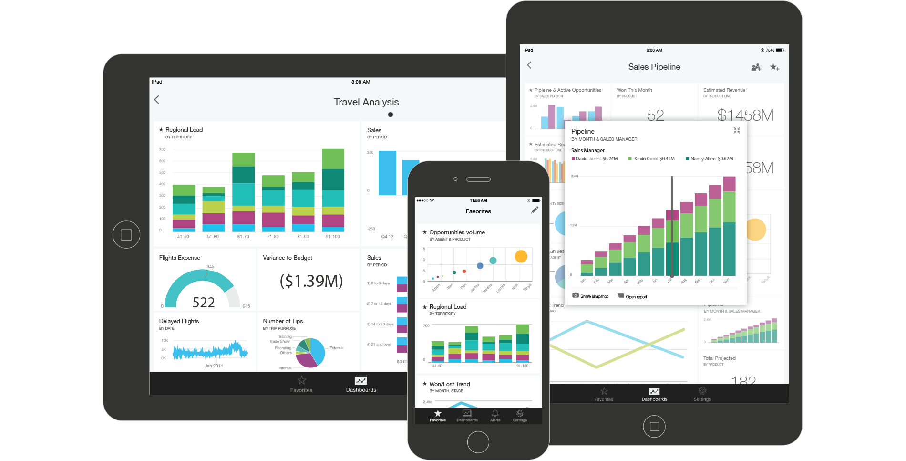





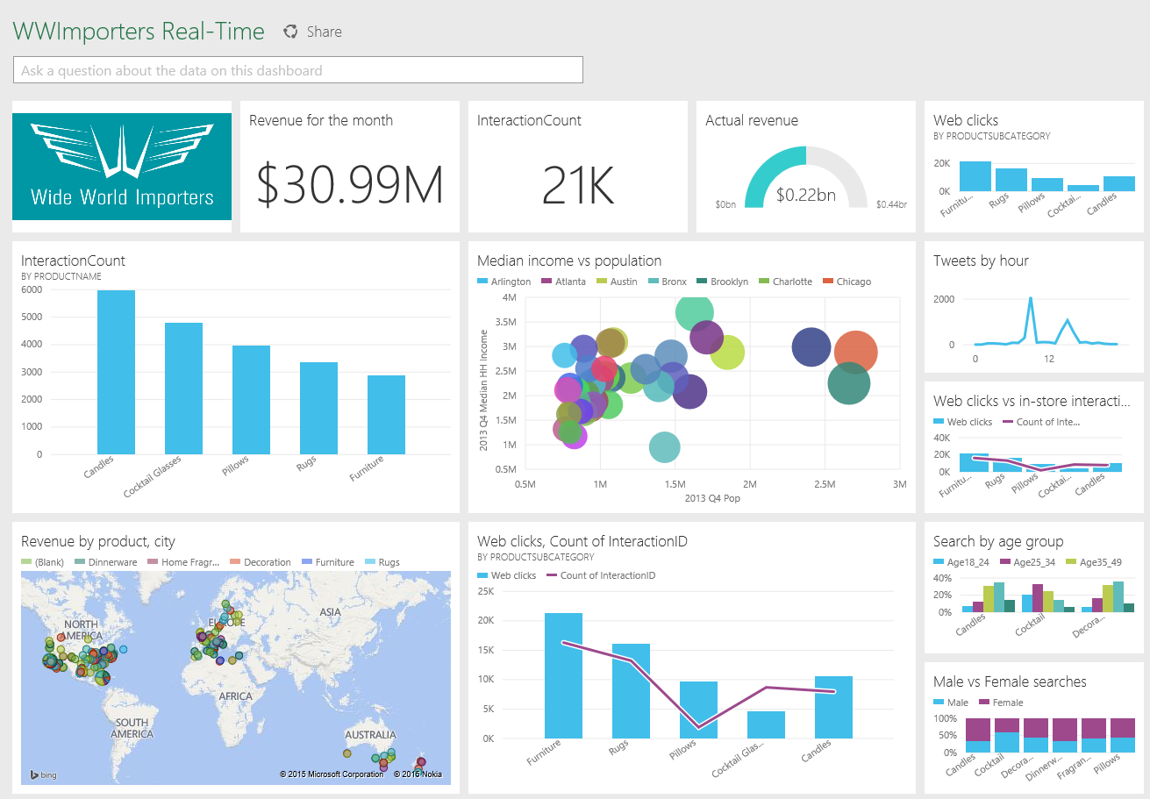
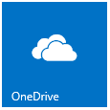


Power BI Technical Architecture
Bring your data…..
…to life
SaaS Data Sources
Power BI web browser
With natural language query, visual exploration etc.
Power BI Mobile Apps
with dashboards, alerting and visual exploration
Azure-resident systems
Azure SQL
Azure Stream Analytics
Excel
Data can be cached or directly queried in place
Publish
Databricks
Power BI Desktop
Real time Dashboards using Push API or ASA
On-premise systems / other
Author
On Premise Data Gateway
SQL / APS
Data Refresh and/or Live Connections
Corporate Data Sources
SSAS and Others

Slide 6
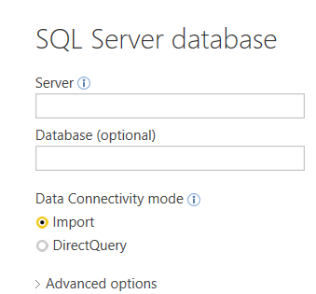
Power BI Authoring Datasets - cached (imported) versus live (direct query)
The building blocks of authoring content in Power BI are a -
Dataset (aka Data Model) – detailed data, metadata (e.g., table/column names), and relationships among data tables
Report (can be created in the PBI Desktop – and/or in the Power BI Service via a browser)
Dashboard (create in the Power BI Service)
Most Datasets are first built in the Power BI Desktop, with 2 notable exceptions -
Apps (Service Content Packs) e.g., Salesforce, Google Analytics, etc. are created directly in the Power BI Service
They are “imported” datasets (see below) – and may be refreshed on a schedule
Streaming Datasets are also created in the Power BI Service
an API is used to push (stream) data directly into these datasets; they are typically used for “real-time” dashboards
When creating a dataset, the author in most cases decides to either* -
Import data. Data is pulled down, compressed, and saved as part of the Power BI Desktop file (.pbix).
Data from 1-to-many disparate data sources can be mashed-up and related together
Data can be refreshed on-demand
Create a Live Connection (DirectQuery / Connect Live) . A connection to 1 (and only 1) data source.
Only “metadata” (e.g., table names, field names, relationships between tables) is pulled down and stored in the desktop file
Note - support for live connections is limited to a smaller set of data sources (e.g., SSAS, SQL Server, Oracle, SAP Hana, Teradata)
*Composite Models can include DirectQuery and Import data connections - https://docs.microsoft.com/en-us/power-bi/desktop-composite-models

Slide 7
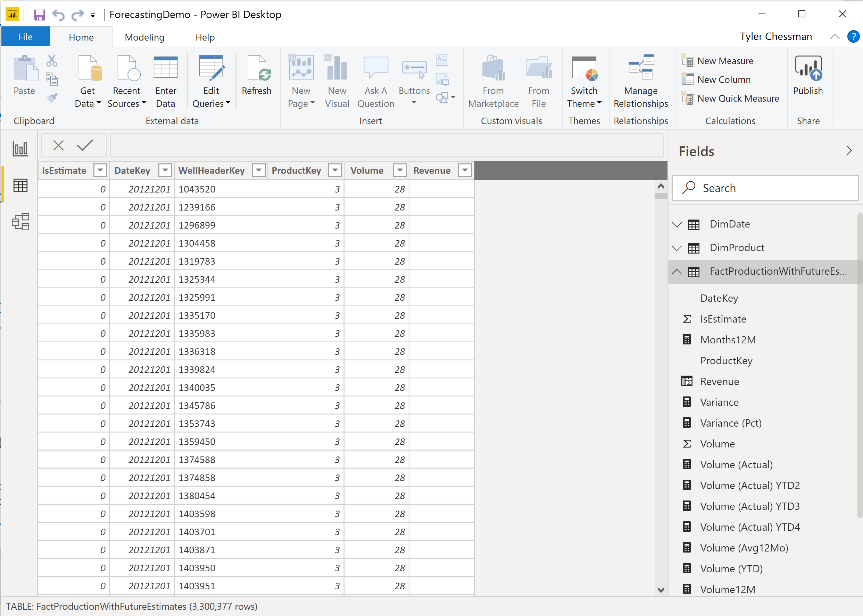
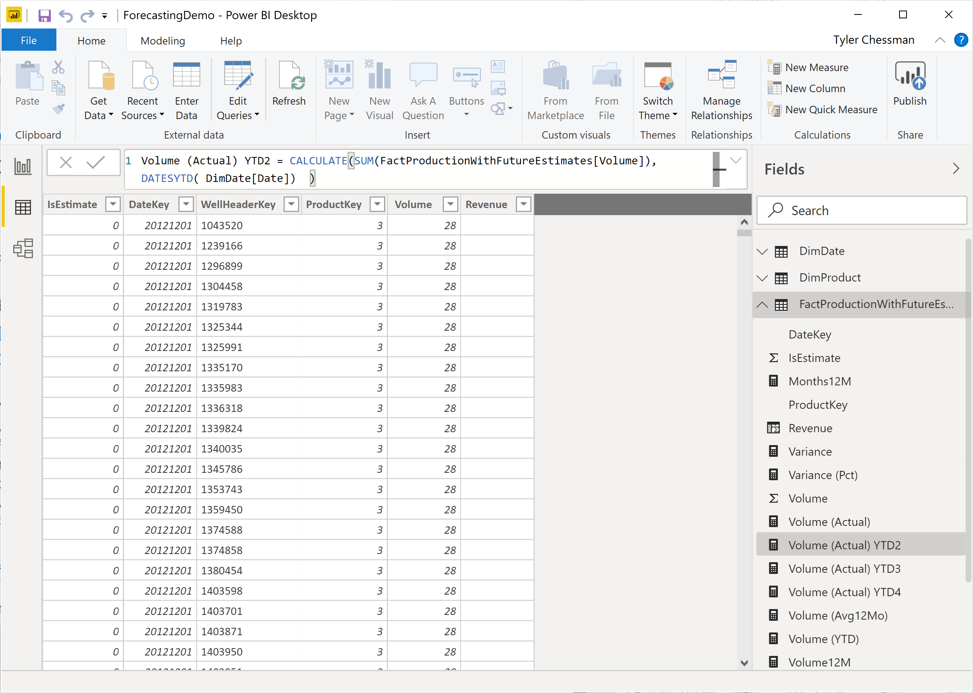
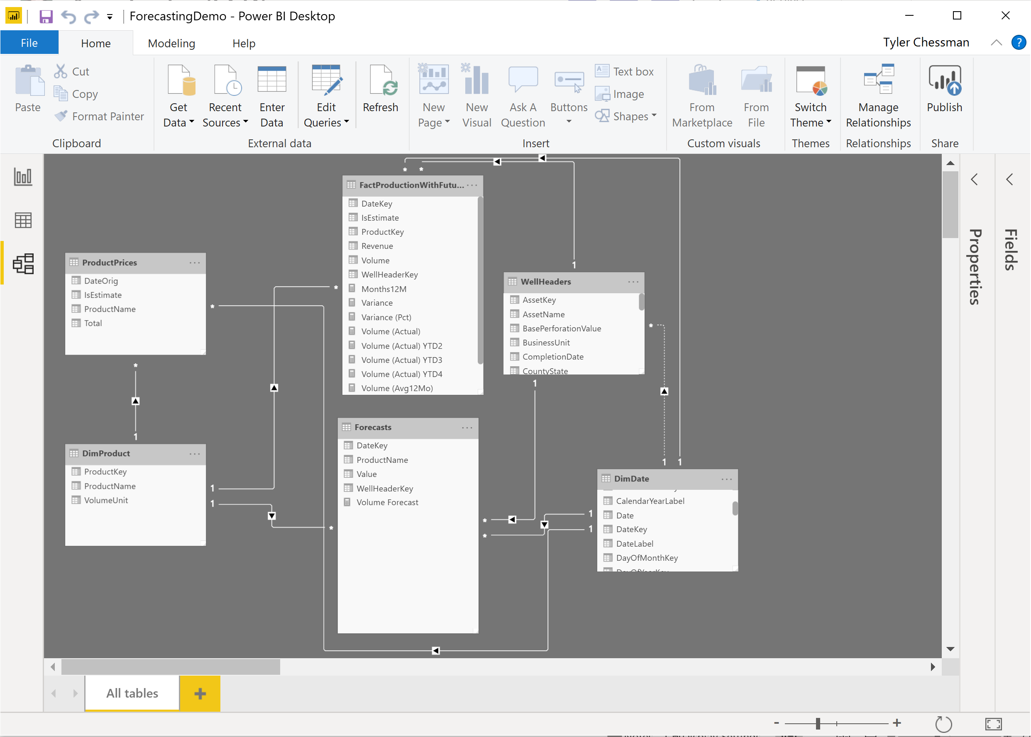
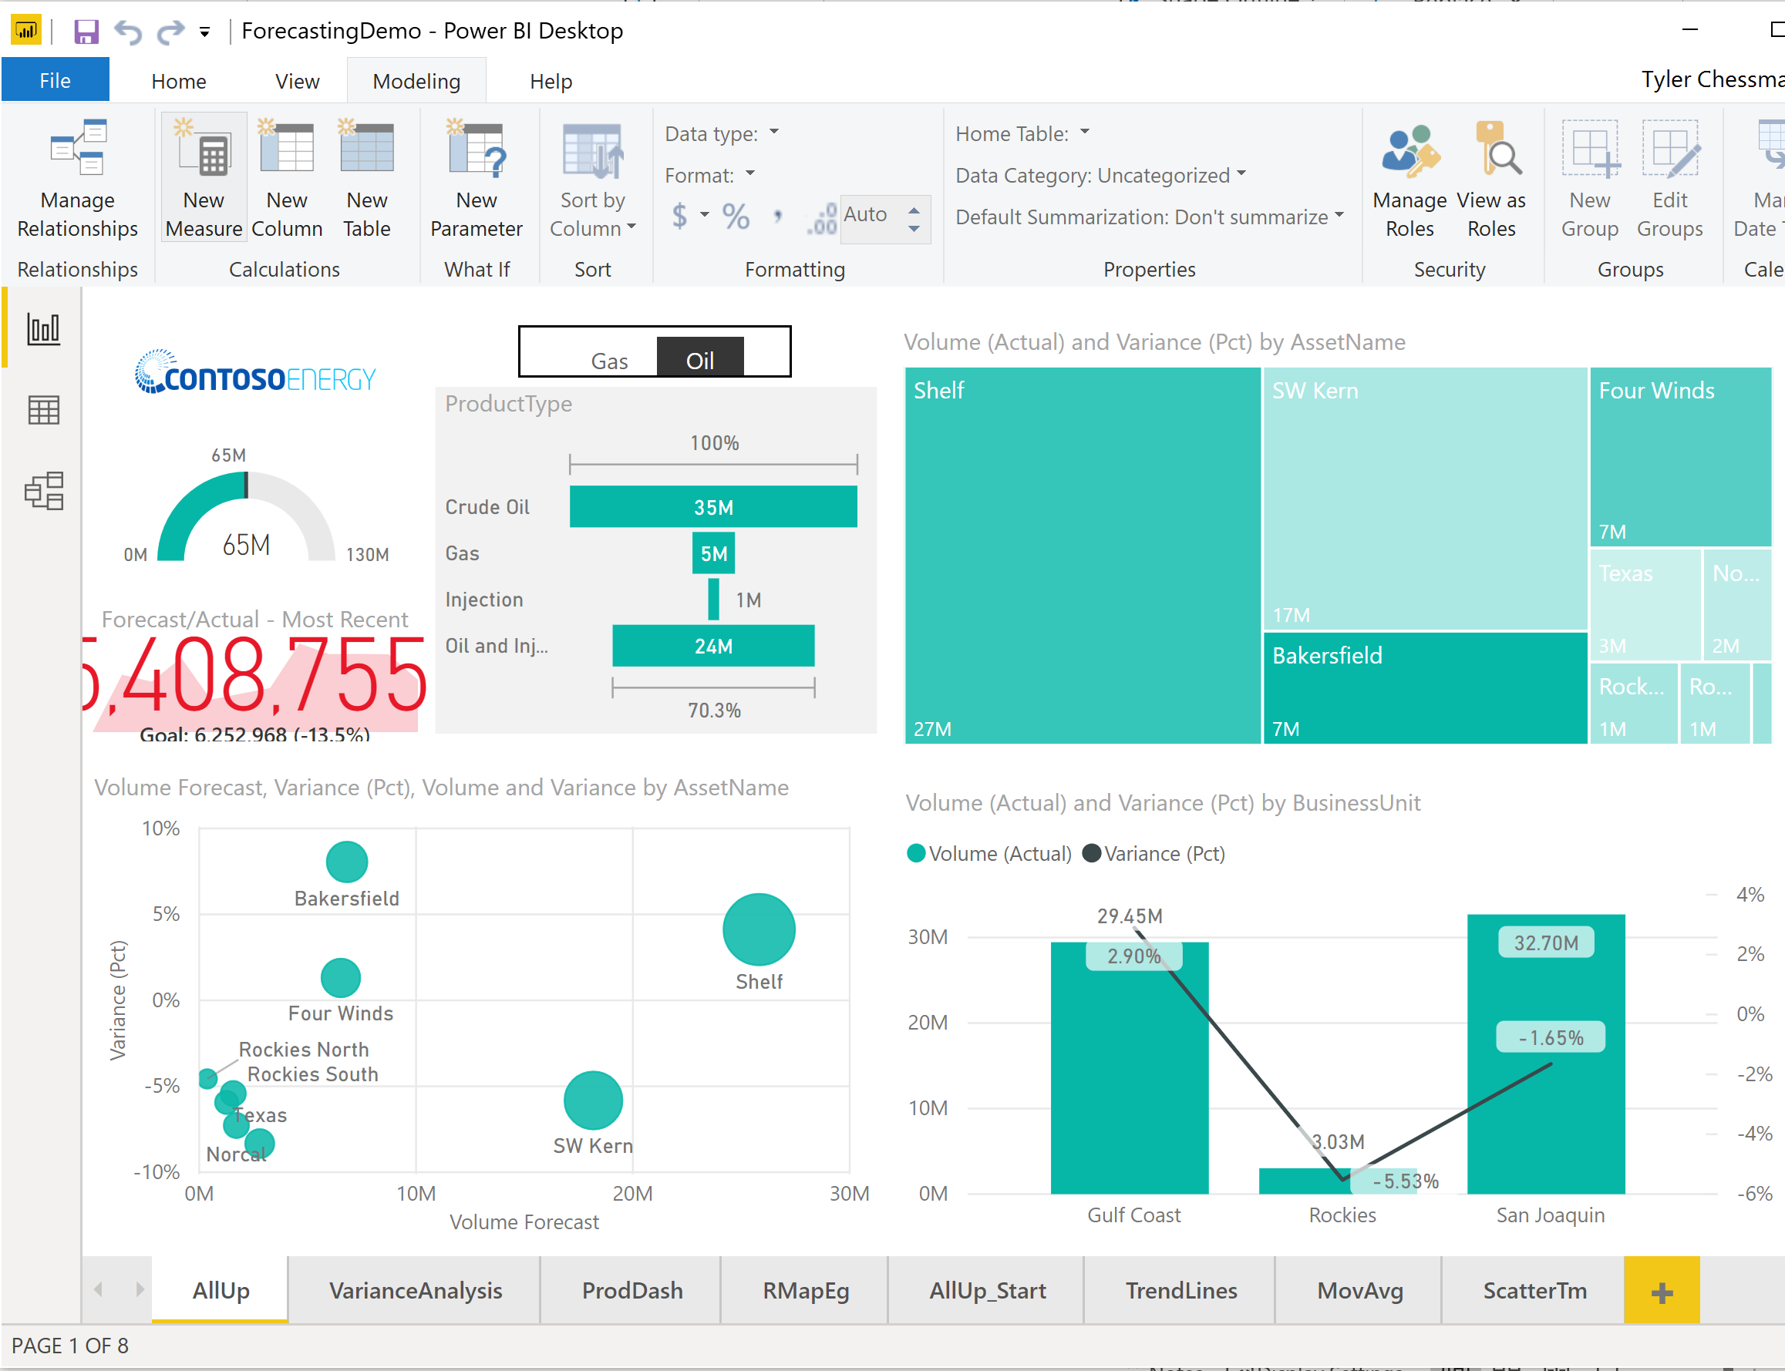
Power BI Authoring Drilldown…. Import, DirectQuery, Connect live
Imported (cached). The author -
Imports data and metadata from data source(s)
May also create calculated columns and measures
Defines relationships among sources
Create a report with 1 or more pages.
Imported data may be refreshed manually or, after publishing, on a schedule (up to 8x in PBI Service, 48x in PBI Premium
Premium also supports incremental refresh
Direct query. The author -
Imports metadata from a data source
May also create calculated columns and measures*
Defines relationships among sources
Creates a report with 1 or more pages.
Every visual is rendered via a real-time query result set.
Once published, a gateway can may be used for on-prem data source
Connect Live. The author -
Connects to a cube/perspective
May also create additional measures (Tabular only)
*https://docs.microsoft.com/en-us/power-bi/desktop-use-directquery#limitations-of-directquery

Slide 8
Dataset Decision Criteria, Capabilities, and Examples
Model Size
< 1 GB
1 GB - 10 GB
10 GB – 400 GB
400 GB +
Refresh Requirements
Daily to 8x a day
Up to 48x daily
Every few minutes
Real-time
PBI Service – 1 GB, 8x daily refresh (full)
PBI Premium – 10 GB*, 48x daily refresh (full / incremental)
Azure Analysis Services – 400 GB, unlimited refresh (full / incremental)
Alternatively supports a limited set of DirectQuery sources
SQL Server Analysis Services – ~4 TB, unlimited refresh
Alternatively supports a limited set of DirectQuery sources
Example Scenarios
I have a 400 MB data set; it needs to be refreshed nightly. Recommendation – PBI Service/Premium
I have a 2 GB data set; it need to be refreshed nightly. Recommendation – PBI Premium
I have a 2 GB data set that needs to be refreshed every 10 minutes. Recommendation – Azure Analysis Services
I have a 25 GB data set; it needs to be refreshed on the hour. Recommendation – Azure Analysis Services
I’ve developed a report against my relational DW (which is 20 TB). The data is refreshed is throughout the day. Recommendation – DirectQuery, or perhaps consider a composite model with aggregations
* Power BI Premium Large Model Support - https://docs.microsoft.com/en-us/power-bi/admin/service-premium-large-models

Slide 9
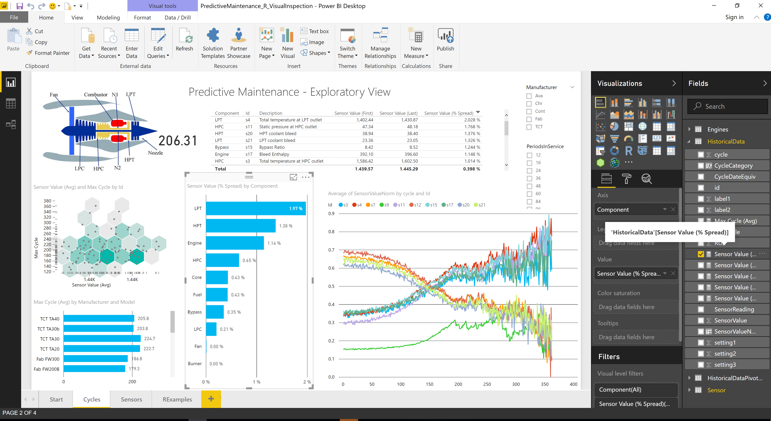
Power BI Authoring Building a Report
In the Desktop, the author chooses columns from the dataset to create tables and charts
A Report is similar to an Excel workbook - it can contain multiple “pages” (worksheets)
Building a report against a live or imported connection is essentially the same experience
The author can save the dataset/report as needed
Everything is saved in a .pbix file
The author can email the .pbix file to someone else, place it on a file share, etc.
Anyone else with the Power BI Desktop can then open/edit it.
Most enterprise organizations will want to “publish” the file for easy consumption..

Slide 10
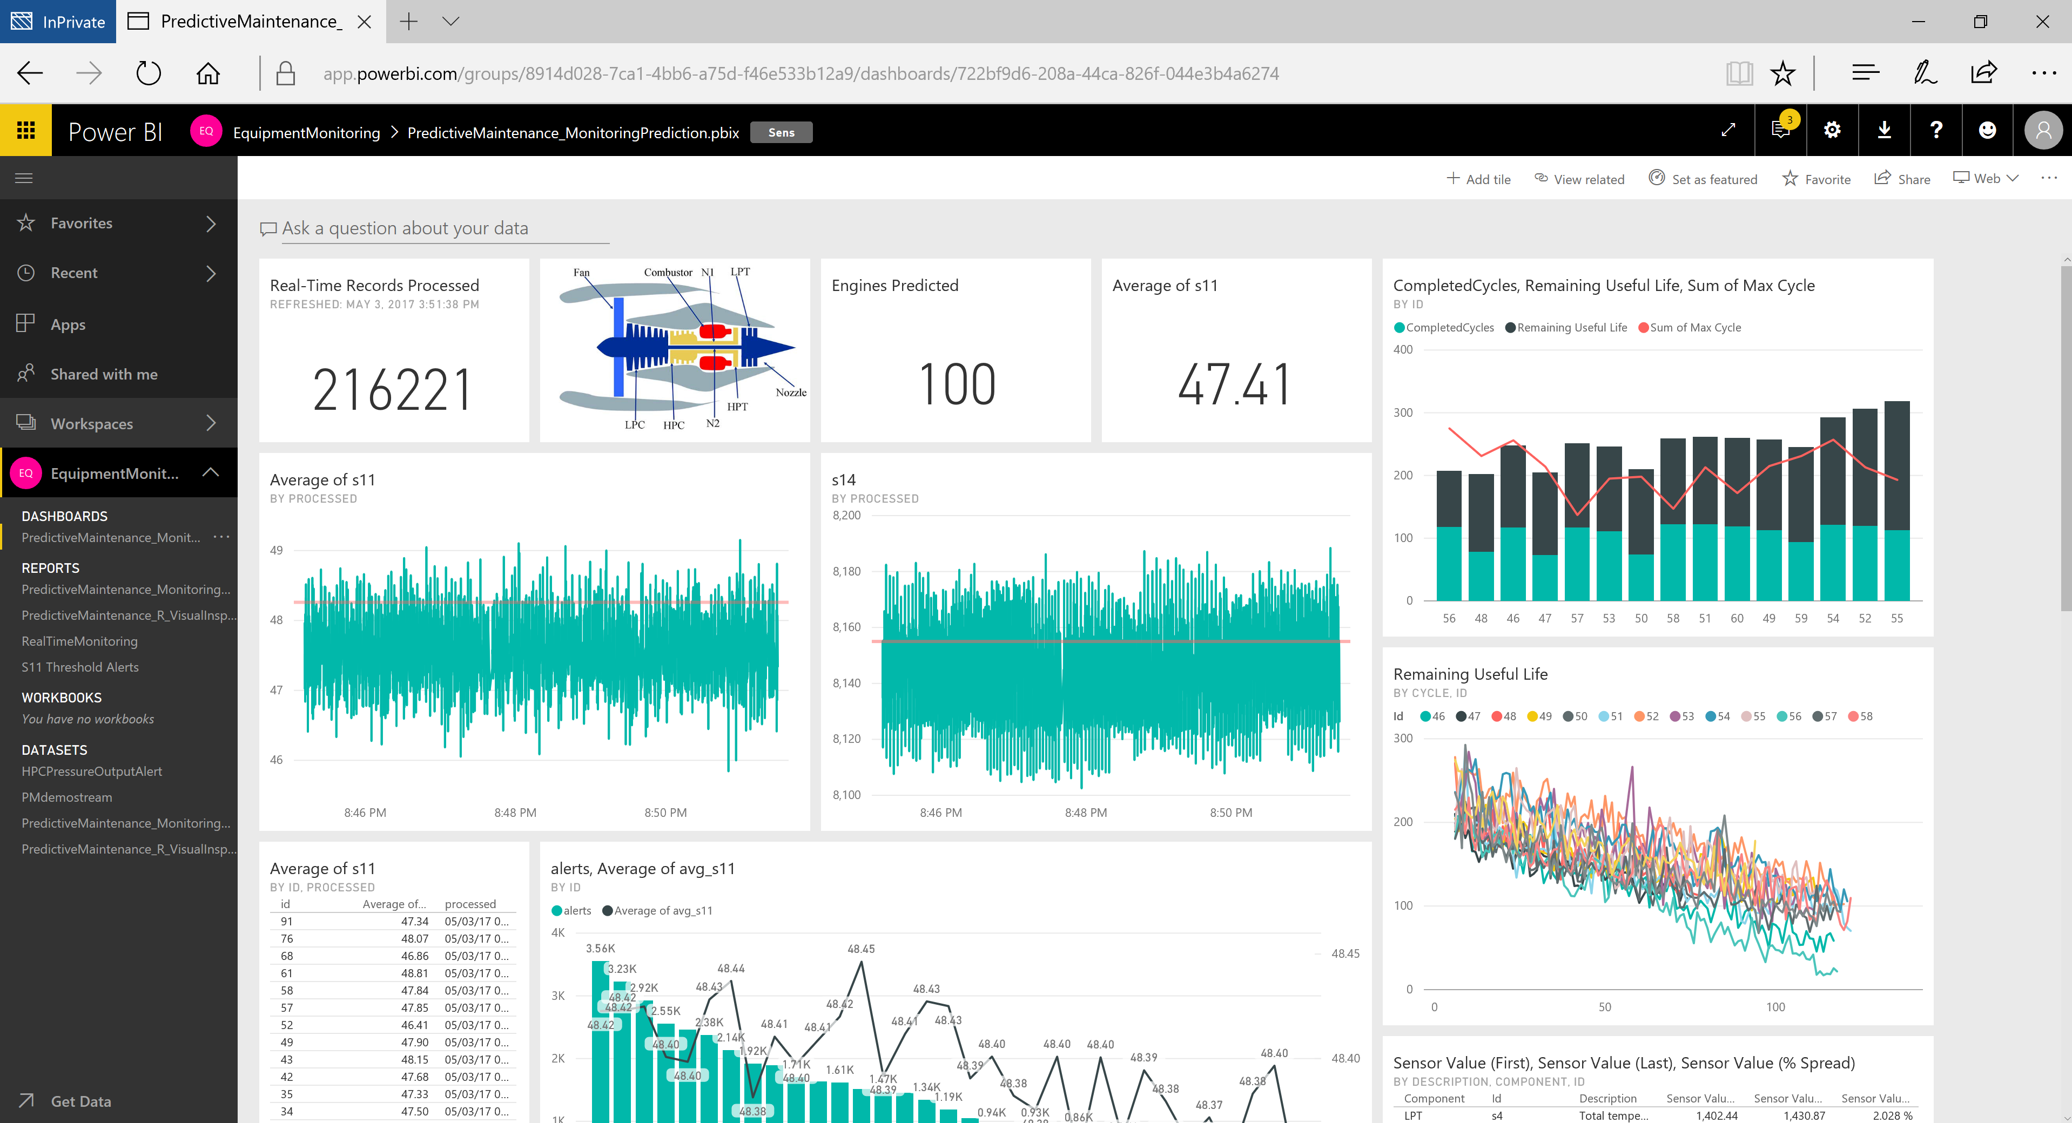
Power BI Authoring Publishing to the Power BI Service
The author publishes the Power BI Desktop file to the Power BI Service
Remember – the .pbix file contains a data set (live or imported) along with a report
These two components (dataset and report) are split out and stored in a workspace
Note – we also support publishing Excel workbooks to the Power BI Service
After the file is published, the author can
Edit and/or create new reports directly in the browser
Schedule data refresh (requires a gateway)
Build a dashboard (a collection of visuals from one or more reports/datasets)
Share the dashboard/report/dataset with others
A note about Workspaces
Every user has a personal “My Workspace”
A user may be a member of other group Workspaces
A Workspace contains Datasets, Reports, and Dashboards
We will cover this in more detail during the publishing topic

Slide 11




Power BI Service Shared Service, Premium, On-Premise Report Server
As of June, 2017….
The Power BI Service is available in both Shared and the new “Premium” mode
Shared Mode
Licensed by user (Pro licenses)
Multiple tenants on shared hardware
Premium Mode
Licensed by user (Pro licenses for authors) and v-cores
Consumers don’t need a Pro license
Update – Per-User license mode
Dedicated hardware
Power BI Service
Shared capacity
CPU/RAM allocation
Power BI Premium
Sales model 1
Sales model 2
Dedicated capacity
CPU/RAM allocation
Sales model 3
Sales model 1
Other models
Other models
Sales model 2
Other models
Sales model 3
Other models
Other models
➔
Ensure consistent performance
Other models
Other models
Other models
➔
Scale on-demand
Models run on distributed hardware servicing multiple tenants
Company 1
Company 2
Company 3
The Power BI Report Server is available for on-premise deployments
Power BI Desktop files can be published alongside traditional SSRS reports

Slide 12
Power BI Premium Additional Capabilities
Current (as of Mar 2020)….
Larger Imported Models (>1 GB)
https://docs.microsoft.com/en-us/power-bi/service-premium-large-datasets
Higher dataset refresh rate (48 per day)
Larger Storage Capacity (100 TB)
Incremental refresh (for imported models)
https://docs.microsoft.com/en-us/power-bi/service-premium-incremental-refresh
Geo-specific deployment of Premium capacity
https://docs.microsoft.com/en-us/power-bi/service-admin-premium-multi-geo
Paginated (rdl) reports
Automated Machine Learning
In Preview and/or Coming in the future..
Even larger models, and higher refresh rates
Generation 2 architecture, including greater scalability, performance, auto-scale, and reduced management overhead - https://powerbi.microsoft.com/en-us/blog/announcing-the-upcoming-evolution-of-power-bi-premium-to-enterprise-markets-and-beyond/
https://docs.microsoft.com/en-us/power-bi/service-premium
https://docs.microsoft.com/en-us/power-platform-release-plan/2020wave2/

Slide 13
DEMO Build/Publish Report

Slide 14
Roles and Responsibilities Common Areas/Tasks and role mappings
Business Sponsor
Azure AD administrator
Office 365 Global Admin
Provisioning
dependent services, software, licenses
Training and Education
Basic on-boarding, how-to’s, company standards, tips/tricks, knowledge sharing
Data Access and Usage
Approved sources, master data, sharing and publishing policies
Authoring
Creating/connecting to datasets, creating reports
Publishing
Open to all or some, approval process required
Sharing
Individual versus teams vs corporate wide
Securing
Data (at-rest & in-transit; on-premise & cloud), authentication/authorization
Monitoring and Auditing
Publishing, Creating, Sharing, Exporting, and Deleting of content
Power BI Champion
Data Steward
Power User/Analyst
BI Practitioner/IT Developer
BI Architect
Security Architect
Power BI Administrator

Slide 15
Provisioning Dependent Services
Azure AD administrator
Office 365 Global Admin
Azure Active Directory (Azure AD, AAD)
Required for user authentication – used by a variety of 3rd party & Microsoft services – Office 365, Exchange Online, SharePoint Online, Power BI, etc.
In Power BI, AD security groups can also be used to help securing/distributing content to end-users.
Large enterprises will synchronize their on-premise Active Directory with Azure AD to provide a single sign-on experience
AAD Connect - https://docs.microsoft.com/en-us/azure/active-directory/connect/active-directory-aadconnect
Action Item - Check with your internal Domain Administrators/Security Team to determine the current state of AAD integration
Office 365
Technically, Power BI doesn’t require Office 365 licensing. But, it does use Office 365 artifacts/management capabilities
The Office 365 Admin portal is also used for license management (you can use Power Shell scripting as well)
Many organizations already have some Office 365 licensing in place
Action Item – Find out if your organization is using Office 365, and contact the Office 365 Global Admin
The Office 365 Global Admin has administrative rights over Power BI, but he can delegate a “Power BI Service Administrator” role
“Your account needs to be marked as a Global Admin, within Office 365 or Azure Active Directory, or have been assigned the Power BI service administrator role, to get access to the Power BI admin portal.”
https://powerbi.microsoft.com/en-us/documentation/powerbi-admin-administering-power-bi-in-your-organization/
https://powerbi.microsoft.com/en-us/documentation/powerbi-admin-role/ . Note, this role does not provide….
Ability to modify users and licenses within the Office 365 Admin Center
Access to the audit logs

Slide 16
Provisioning Users and Software
Azure AD administrator
Office 365 Global Admin
Power BI Admin
Power BI Champion
Power BI Desktop - https://powerbi.microsoft.com/en-us/desktop/
The authoring tool for Power Users/IT Developers (and anyone else who is going to author and publish content)
A free application, it has no dependency on the Power BI Service; requires local administrative rights to install on a machine
Updated monthly – though you don’t have to install every update; some organizations are choosing to perform controlled quarterly rollouts
E.g., https://blogs.msdn.microsoft.com/samlester/2016/09/30/installing-power-bi-desktop-through-sccm/
Action Item – Develop Power BI Desktop rollout and update strategy
Power BI Gateway – covered later
Power BI Service – data center location*
https://www.microsoft.com/en-us/trustcenter/privacy/powerbi-location
Power BI Service – User Licenses
By Default, users can self-sign up for a Power BI Free license
The free license is now severely limited – no sharing capabilities. Free license users can automatically bump themselves up to a 60-day Pro trial
Action Item – Consider blocking individual sign up - https://powerbi.microsoft.com/en-us/documentation/powerbi-admin-powerbi-free-in-your-organization/. Instead, assign licenses in mass or as part of an employee on-boarding process
Power BI Pro licenses are required for any users who want to publish/share/modify content.
Users who want to view content shared by a Pro user will also need a Pro license – or an Organization may consider the use of Power BI Premium
Action Item – Identify end-user community of authors and consumers. Look at licensing/pricing, and evaluate against performance requirements
https://powerbi.microsoft.com/en-us/pricing/
Notes:
*

Slide 17
Training and Evangelism Role out strategy
Power BI Champion
BI Architect
Identify Training Needs
Power Users – Gather/Store Data, Build Data Models, Build Initial Reports, Publish Content, Share Content
Consumers – Find Content, Explore Dashboards/Reports (extend dashboards/reports?)
Administrators – Today!
Build Internal Awareness for the masses
Present and record internal presentations/webinars (~1.5 hours) – conduct multiple times and make available for on-demand viewing
Consider Hands-On Training for Power Users
Dashboard in a Day Sessions often held at local Microsoft Offices e.g., https://www.microsoftevents.com/profile/form/index.cfm?PKformID=0x188356617d4
See Next Slide for Online, Classroom, Books, and Self-Paced training options
Conduct “Launch” Event(s)
A repeat of internal awareness content along with Testimonials/internal case studies
Call to actions (any training materials/follow up sessions)
Include training/awareness around any governance policies
Business App Summit, Schlumberger PBI Rollout - https://www.youtube.com/watch?v=yKRdZW5WUVY
~starts at 26 minutes into video, deployment approach at ~34

Slide 18
Training Links and Resources
Power BI Champion
Microsoft provides several free training resources and virtual labs (train yourself):
Getting Started with Power BI - https://powerbi.microsoft.com/en-us/learning/
YouTube Video Library - https://www.youtube.com/channel/UCy--PYvwBwAeuYaR8JLmrfg.
Power BI Documentation - https://powerbi.microsoft.com/en-us/documentation/powerbi-landing-page/
18 new Virtual Labs - http://technet.microsoft.com/en-us/virtuallabs?id=F2Ft/ah2g8Q
NEW! https://www.edx.org/, good course on Power BI - https://www.edx.org/course/analyzing-visualizing-data-power-bi-microsoft-dat207x-2.
Training/learning from 3rd party sources
www.sqlbi.com. Deep expertise on Tabular, Multidimensional, PowerPivot, and DAX. Provide both books and online training. Recommend signing up for their newsletters
Bluegranite. http://msbiacademy.com/
www.powerpivotpro.com. Focus in on PowerPivot.
www.projectbotticelli.com.
Artis Consulting. Great boutique MSFT BI consulting shop that also offers training www.artisconsulting.com
Pragmatic Works. Lots of free training (http://pragmaticworks.com/Training/Courses#type=Free) as well as workshops - http://pragmaticworks.com/Training/Courses#type=Workshop

Slide 19
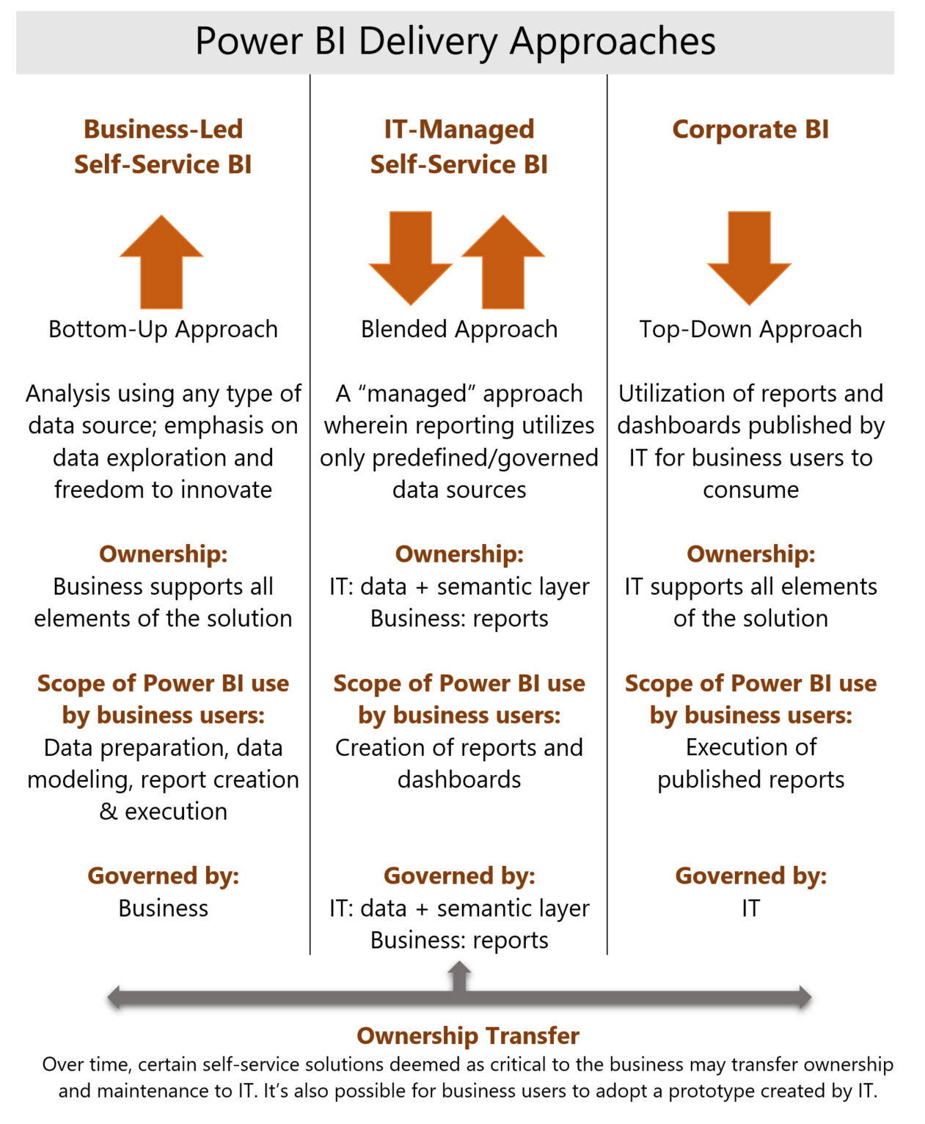
Governance Overview
Definition
“Establishment of policies, and continuous monitoring of their proper implementation, by the members of the governing body of an organization. It includes the mechanisms required to balance the powers of the members (with the associated accountability), and their primary duty of enhancing the prosperity and viability of the organization.” - www.businessdictionary.com/definition/governance.html
It is useful to think about governance in the context of three delivery approaches and corresponding levels of control.
Business-Led Self-Service BI. Business (typically Power) Users -
Have direct access to data (Gather/Store)
The ability to create custom data models (Model) and reports (Analyze)
Publish data model and reports (Share)
IT-Managed Self-Service BI.
IT gathers/stores/models and publishes a data model
Business users build reports and share with others
Corporate BI
Typically a “turn-key” solution. IT delivers a ready-to-consume dashboard
Additional reports/authored tightly controlled
https://powerbi.microsoft.com/en-us/documentation/powerbi-admin-governance/

Slide 20
Governance Key Points and Considerations
Policies
Limit the number of people who can write to and read from the data lake (e.g., developers, data engineers, data scientists)
Develop and implement a consistent data lake taxonomy / storage strategy e.g.
Data Lakes Purposes, Practices, Patterns and Platforms By Philip Russom
https://docs.microsoft.com/en-us/azure/data-lake-store/data-lake-store-best-practices#directory-layout-considerations
https://www.sqlchick.com/entries/2017/12/30/zones-in-a-data-lake
Use a data “catalog” to enable search, discovery, annotation, and surfacing of data sources/elements
Define a process to identify data sources available for analysis – and the steps/workflow that needs to be followed when publishing/sharing data with others (next slide)
Implement a data warehouse based on classic dimensional modeling / fact tables for downstream analytics
Use AAD for authentication
Where applicable, implement RLS to securely filter data (RLS can be re-used by downstream tools e.g., AS, PBI, etc.
Monitoring
Azure Monitor for all-up monitoring
Tool-specific monitoring (e.g, Data Lake, Synapse)
Power BI Tenant-Level Settings & Auditing/Monitoring (covered later)

Slide 21


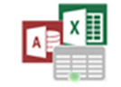
Governance Example Process
1
Data Sources
6
PowerBI.com
Master Data & Data Quality
1
Add New Reporting Data Source
Shared Data Sources
Shared Datasets
Reports and Dashboards
App Workspaces / Apps
2
Perform Data Source Security and Governance Management Tasks
2
Data Governance Stewards
Big Data/Data Lake
Security, Roles, Data Sources, Data Catalog, Master Data Version Control and Audit
3
Publish Approved Shared Data Source for Analysts/Power Users
4
Develop Reporting Content with Approved Shared Data Sources
Cloud Apps, Streams & IoT Data
3
Approved Secure Shared Data Sources, Datasets
via Data Gateway / Workspaces
7
Submit Reporting Content for Approval
based on Governance Guidelines
5
Approval Workflow to Deploy
6
Review, Approve/Disapprove, Add to Catalog for Compliance and Audit
Data Warehouse & App Databases
4
8
5
7
Publish Approved Content with Permissions to Groups
8
View and Explore Power BI Content based on Role/Group Permissions
Power BI Desktop,
Excel, R, Azure ML & other tools
Analysis Services
BI Semantic Models
Analysts/Power Users
Self-Service BI Users

Slide 22
Master Data Management (MDM) Overview and Resources
Definition(s)
Defining and Managing the “nouns” of the business e.g., Employee, Vendor, Product, Customer
Comprised of data cleansing, transformation, and integration practices
May be used to synchronize applications (ERP, CRM, HSE, etc.), to manage hierarchies, and/or as a feeder to analytic systems/data warehouses
Note – in the context of analytics, implementation of a formal MDM product usually comes after a level of analytic maturity is achieved
Microsoft and Partner Capabilities
For on-premise deployments, Microsoft provides master data management capabilities as part of SQL Server Master Data Services (MDS)
Many existing customers use a partner, Profisee, as part of their implementation
Profisee also provides value-added capabilities on top of the MDS platform (e.g., data quality)
Microsoft does not provide a cloud-first, PAAS MDM offering
Profisee offers master data capabilities in Azure – it is a PAAS offering that runs in a customer’s tenant
We recommend customers consider Profisee for cloud-based MDM

Slide 23
Data Sources Managing & Exposing
Data Steward
Power BI Champion
Self-Service BI may require access to original source systems, data warehouses, big-data stores, and/or 3rd party data sources
The Data Steward, along with source systems owners and data administrators, is responsible for providing access to the system(s) they control
Common concerns and issues WRT data sources & Power BI
This tool makes data proliferation easier (Your giving my users a bigger gun)
For imported data models, Power BI is similar to an Excel spreadsheet; it is a local copy of a data source that has been extracted and potentially transformed/blended with other data sources. However, the Power BI Service helps reduce data proliferation (emailing spreadsheets and copying charts/graphs into PowerPoint deck.
Power BI provides a level of auditing/monitoring that isn’t available with local spreadsheets (covered later) – which makes it possible to “upgrade” popular data models to an IT-Managed/Enterprise approach in the future
The data is stored in the cloud – I have security, safety, compliance concerns
Who has access to this data – how do we secure it
Consider a set of PBI Desktop “templates” to standardize data access patterns/practices
Consider the use of a “Data Catalog” to make it easier for
Data Stewards to publish and describe authoritative data sources
Power Users to find/consume these data sources
A Data Catalog could be anything as simple as a set of documents in a portal to a packaged solution….
https://powerbi.microsoft.com/en-us/documentation/powerbi-desktop-data-sources/

Slide 24
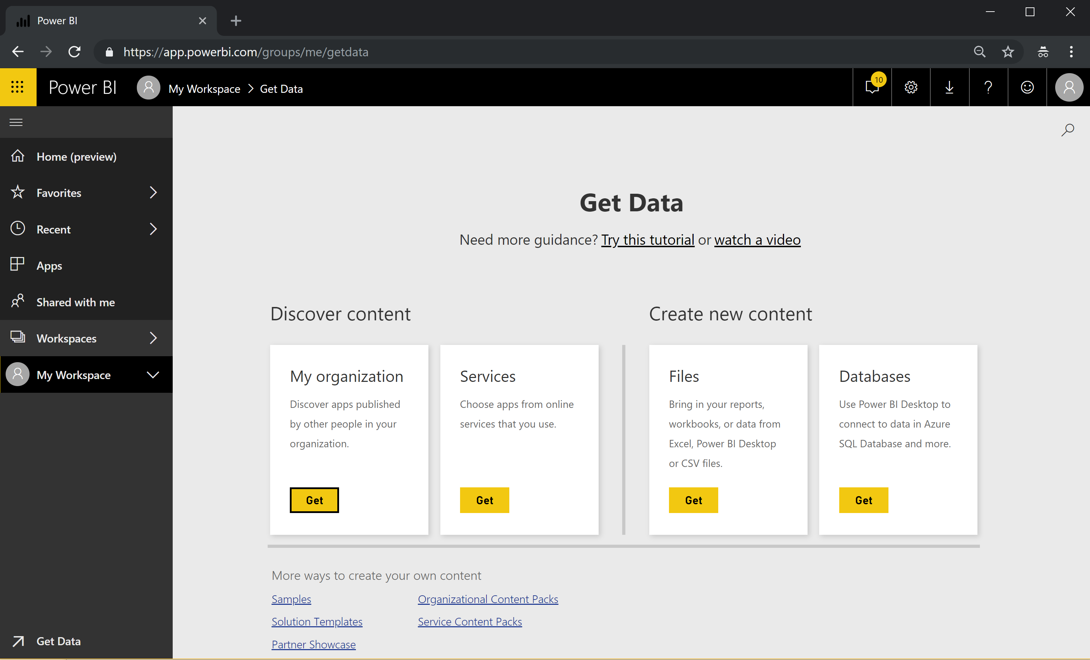
Publishing and Sharing Content Overview
Power BI Champion
Power User
BI Practitioner
How data & reports get into the Power BI Service
Discover Content (“Apps”)
Organizational
Services
Create new content (Power BI Desktop / Excel)
Publish directly from the Power BI Desktop (push)
From within the Power BI Portal (get)
Databases – don’t use!
Where to Publish
My Workspace
App Workspace
What gets Published
Dataset (Imported or Live Connection)
Report
Dashboard (not part of the Power BI Desktop – created in Power BI, may be included in a App)
What can get created (after publishing initial content)
Additional Reports
Dashboards
Planning an Enterprise Deployment - https://powerbi.microsoft.com/en-us/documentation/powerbi-whitepapers/

Slide 25
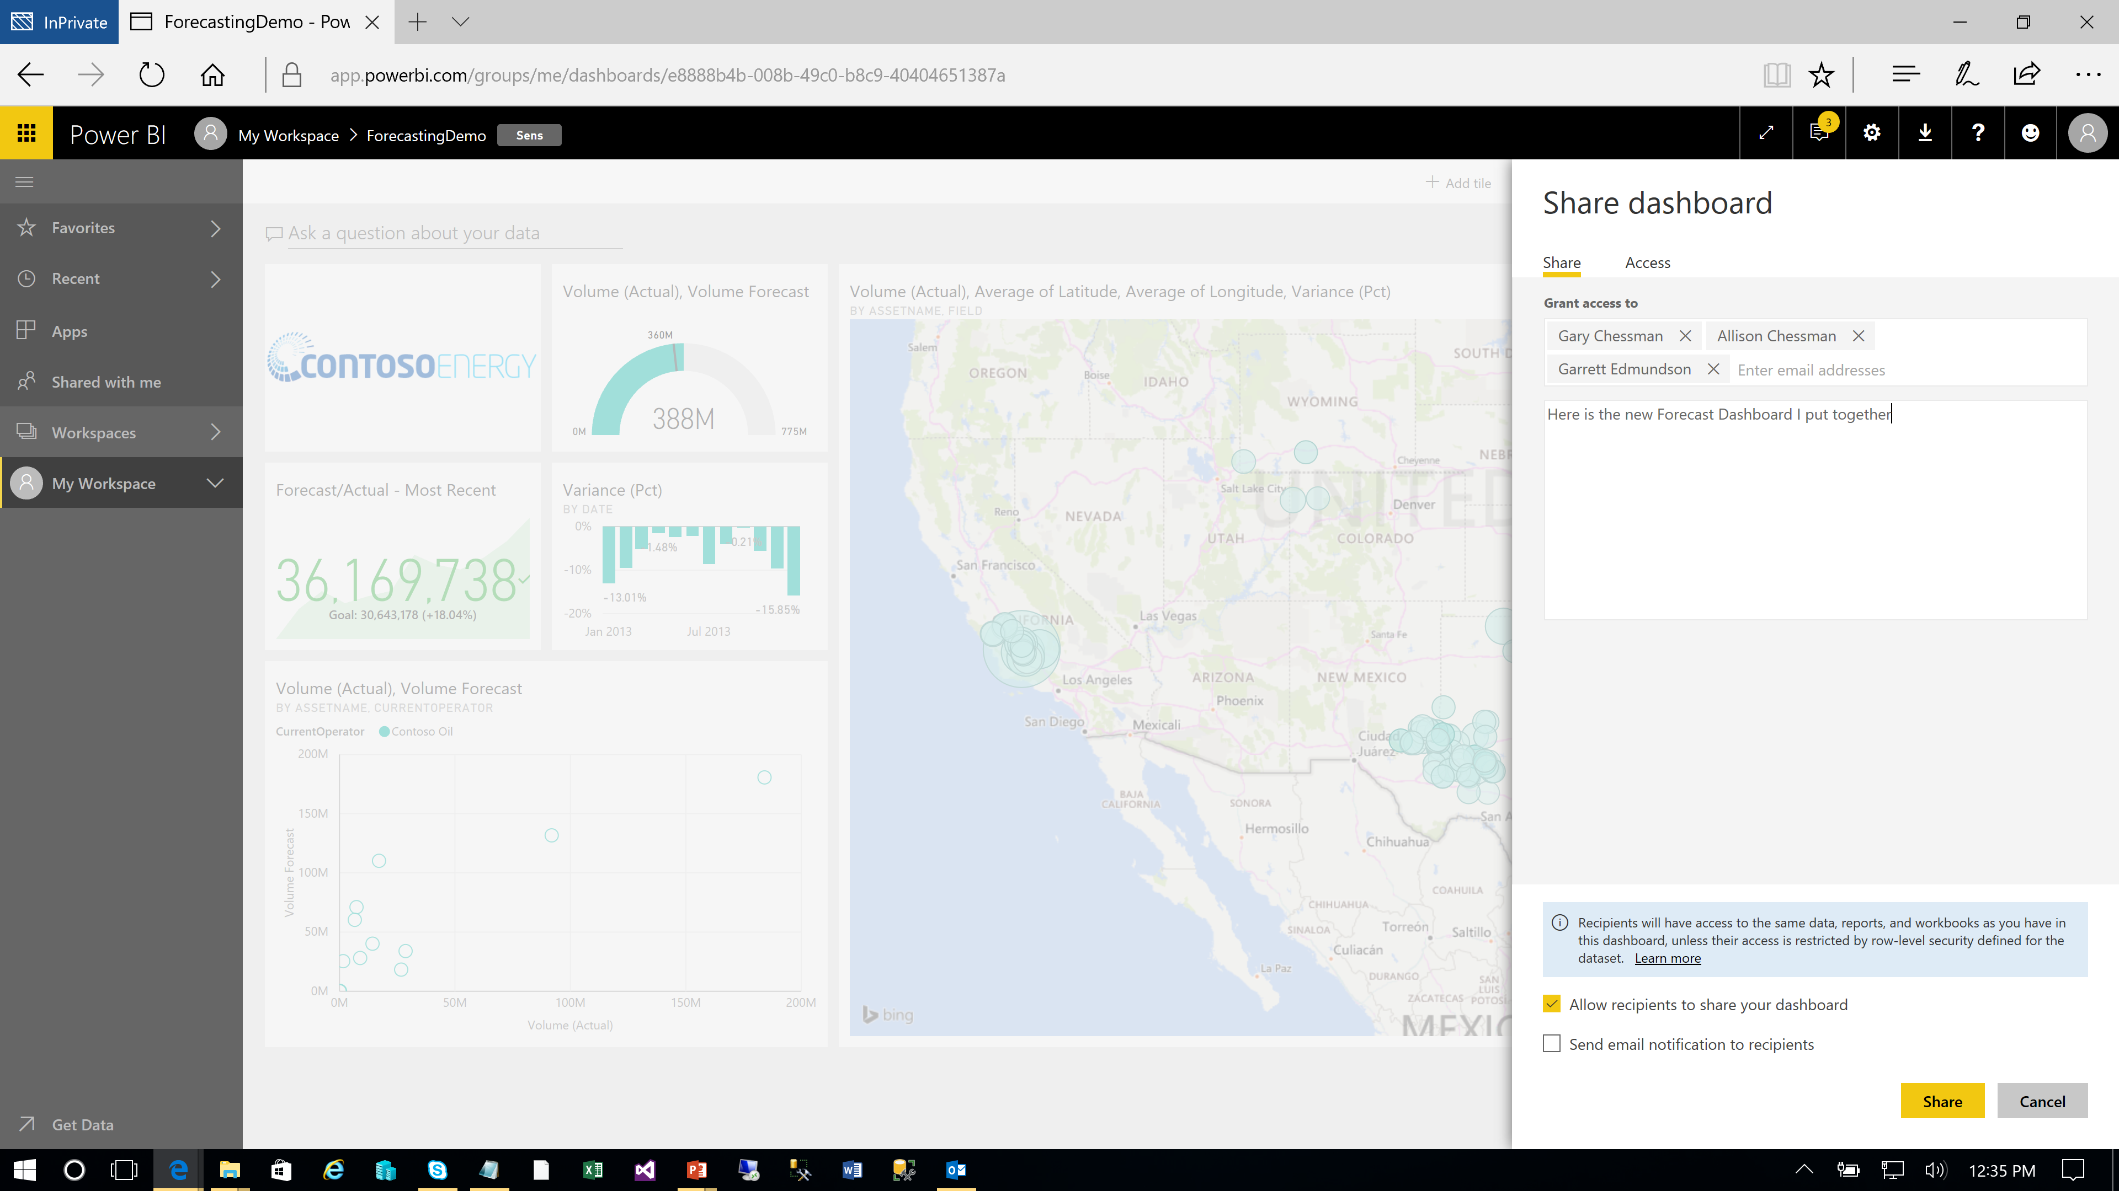
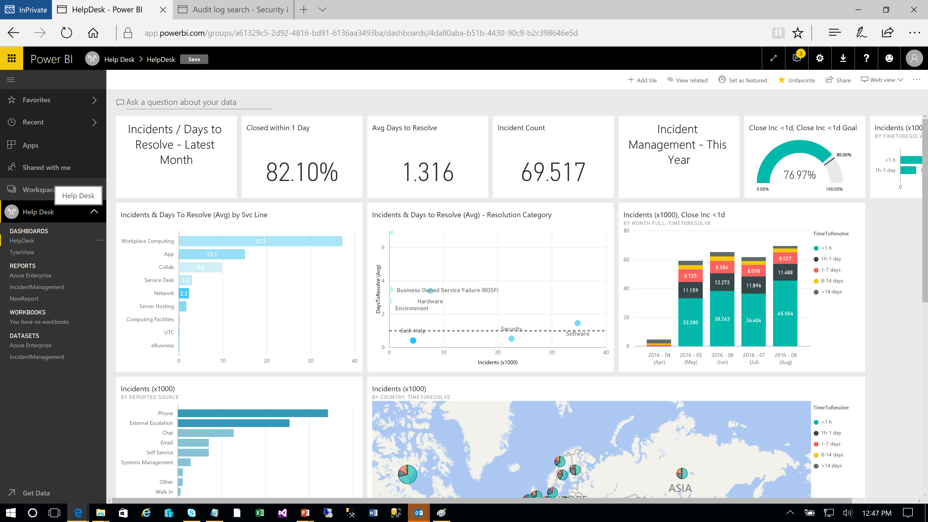
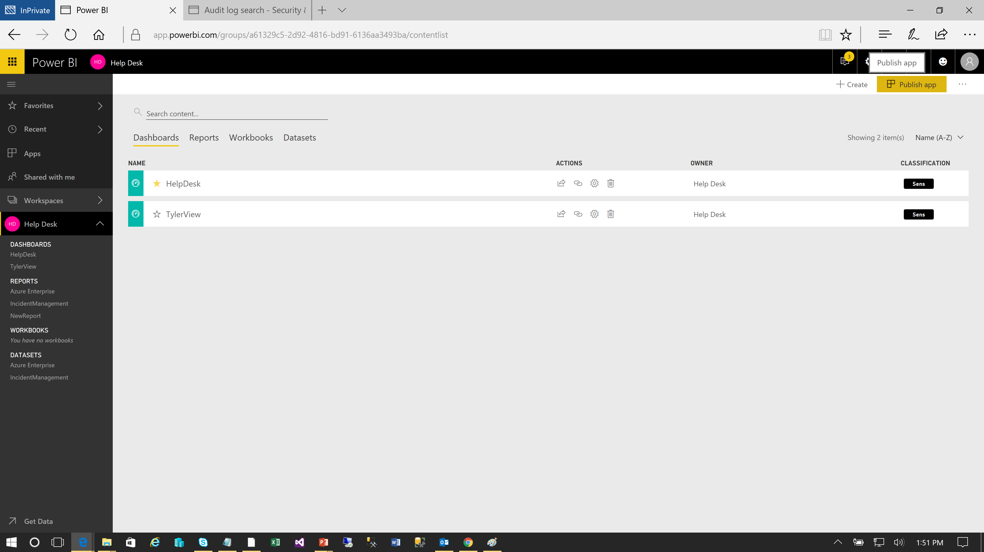
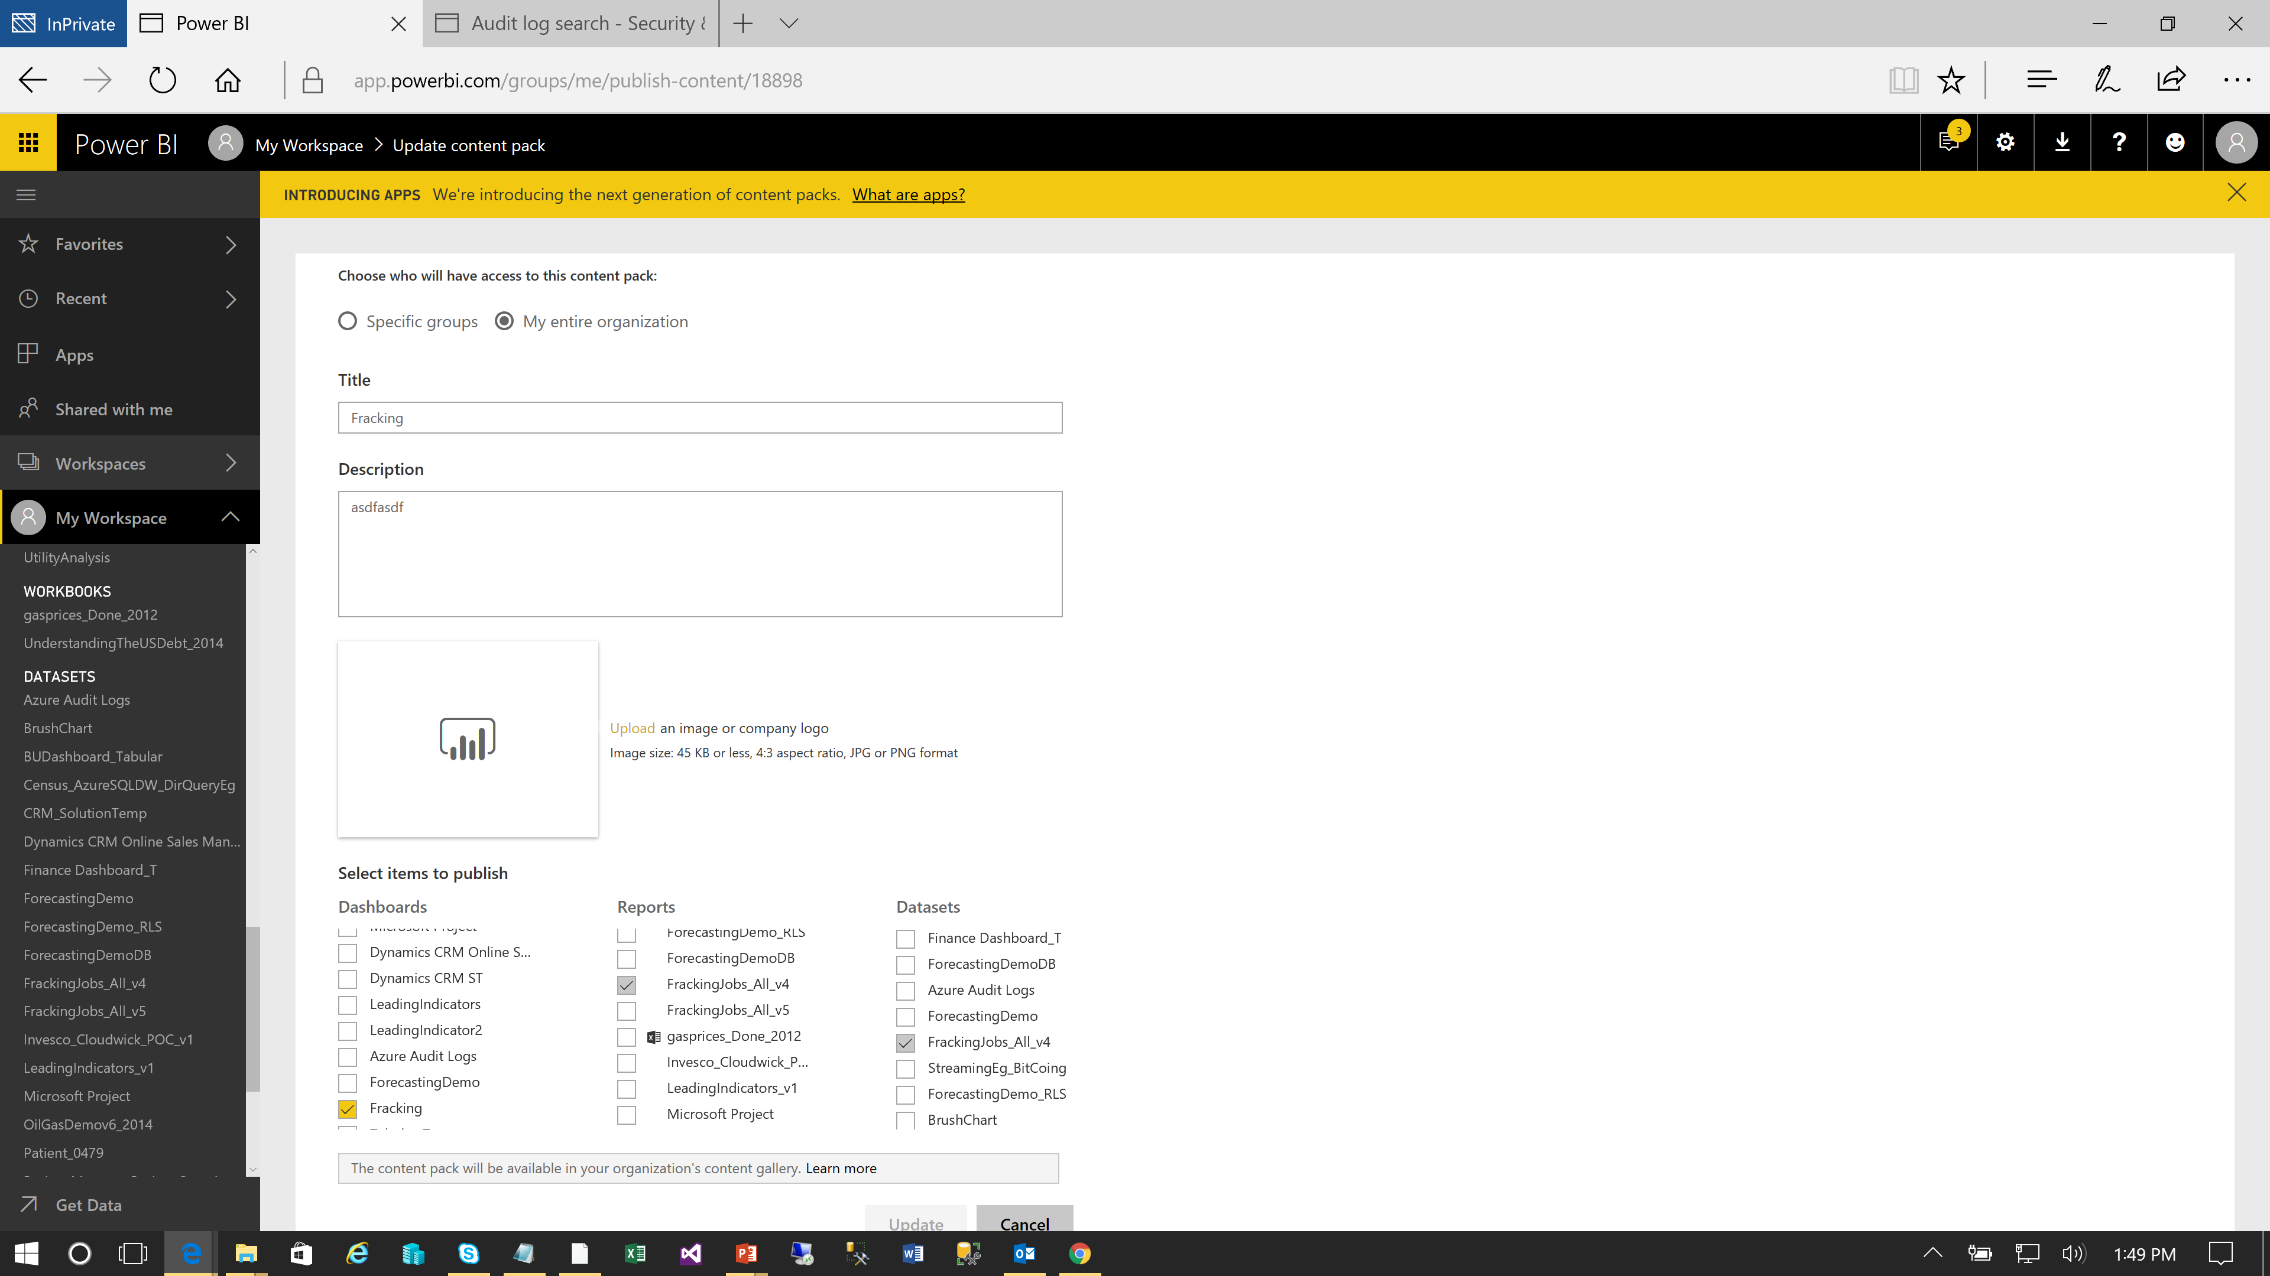
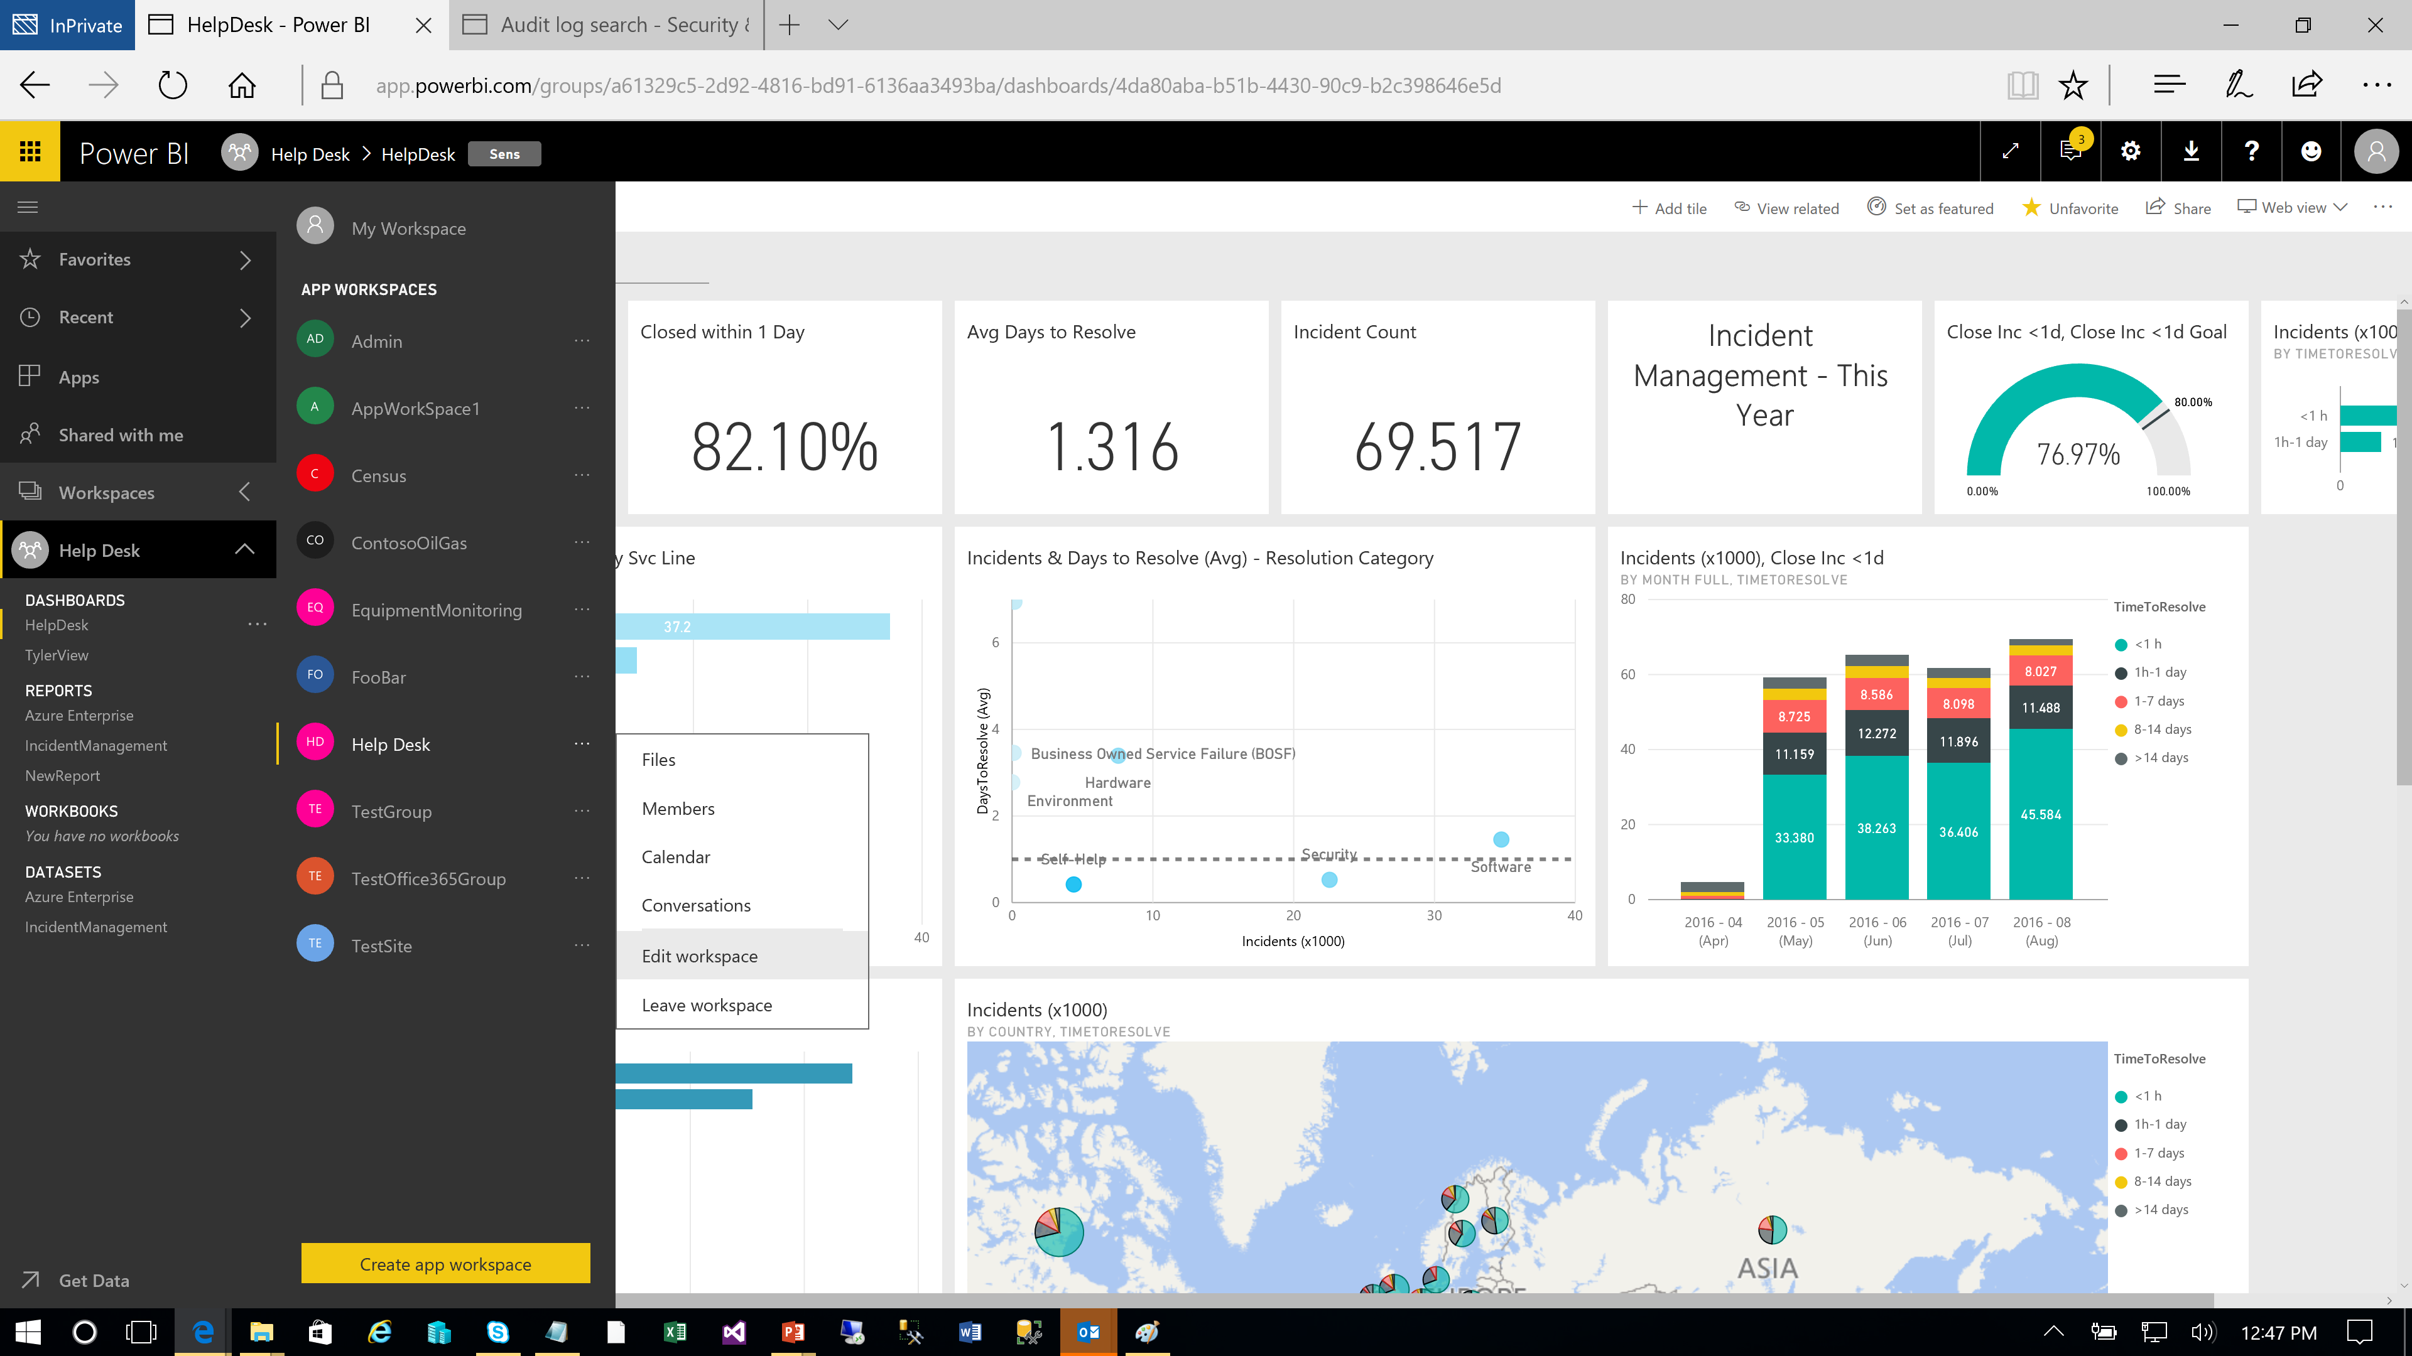
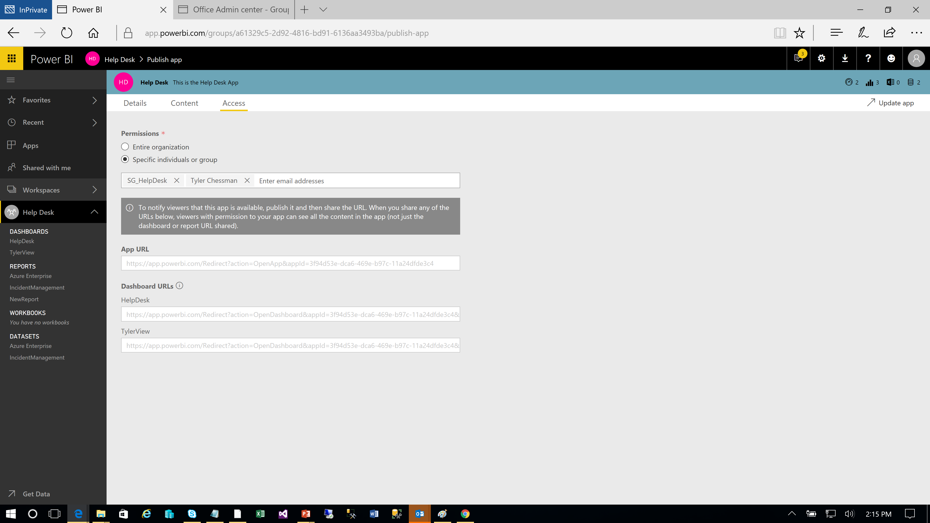
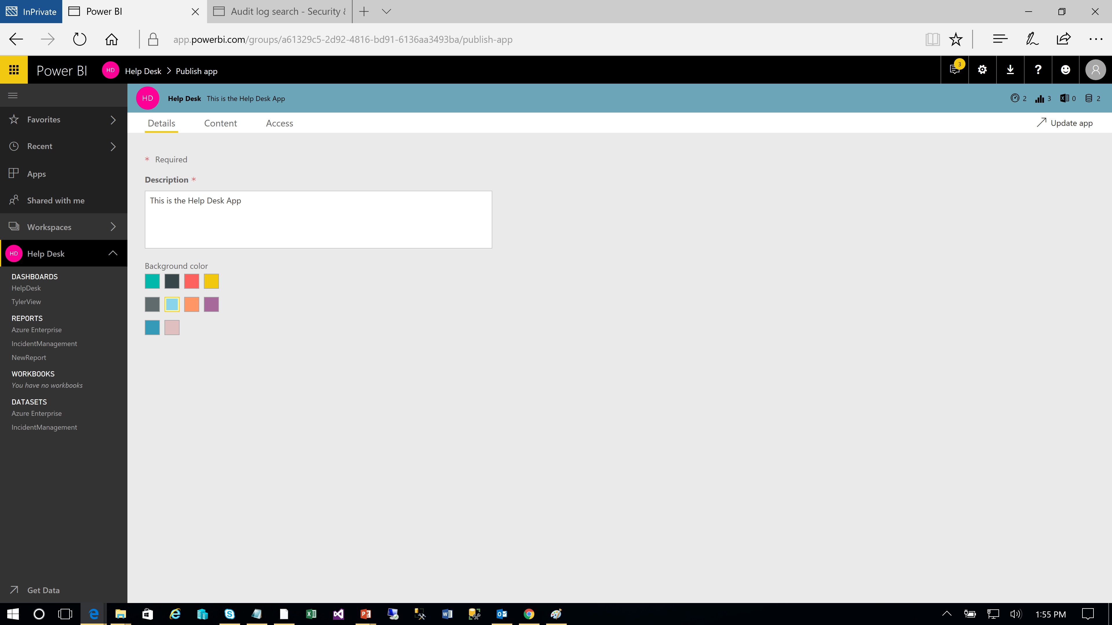
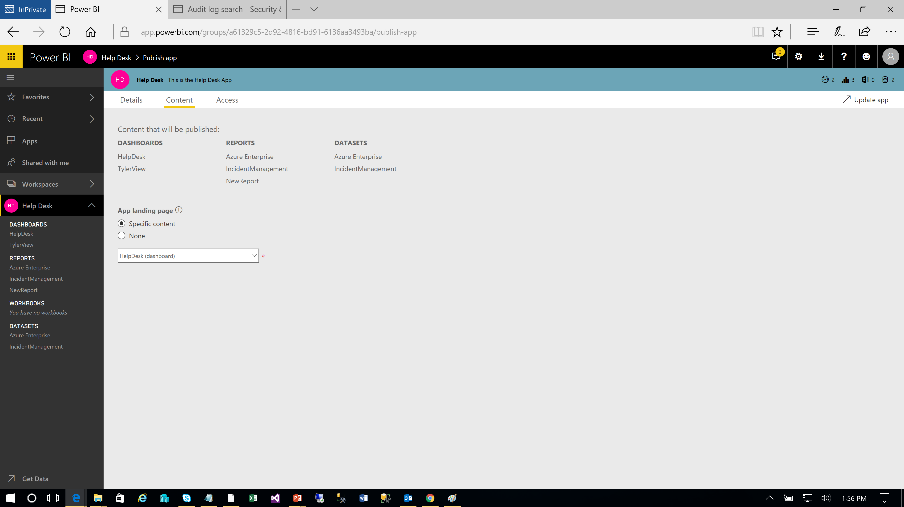
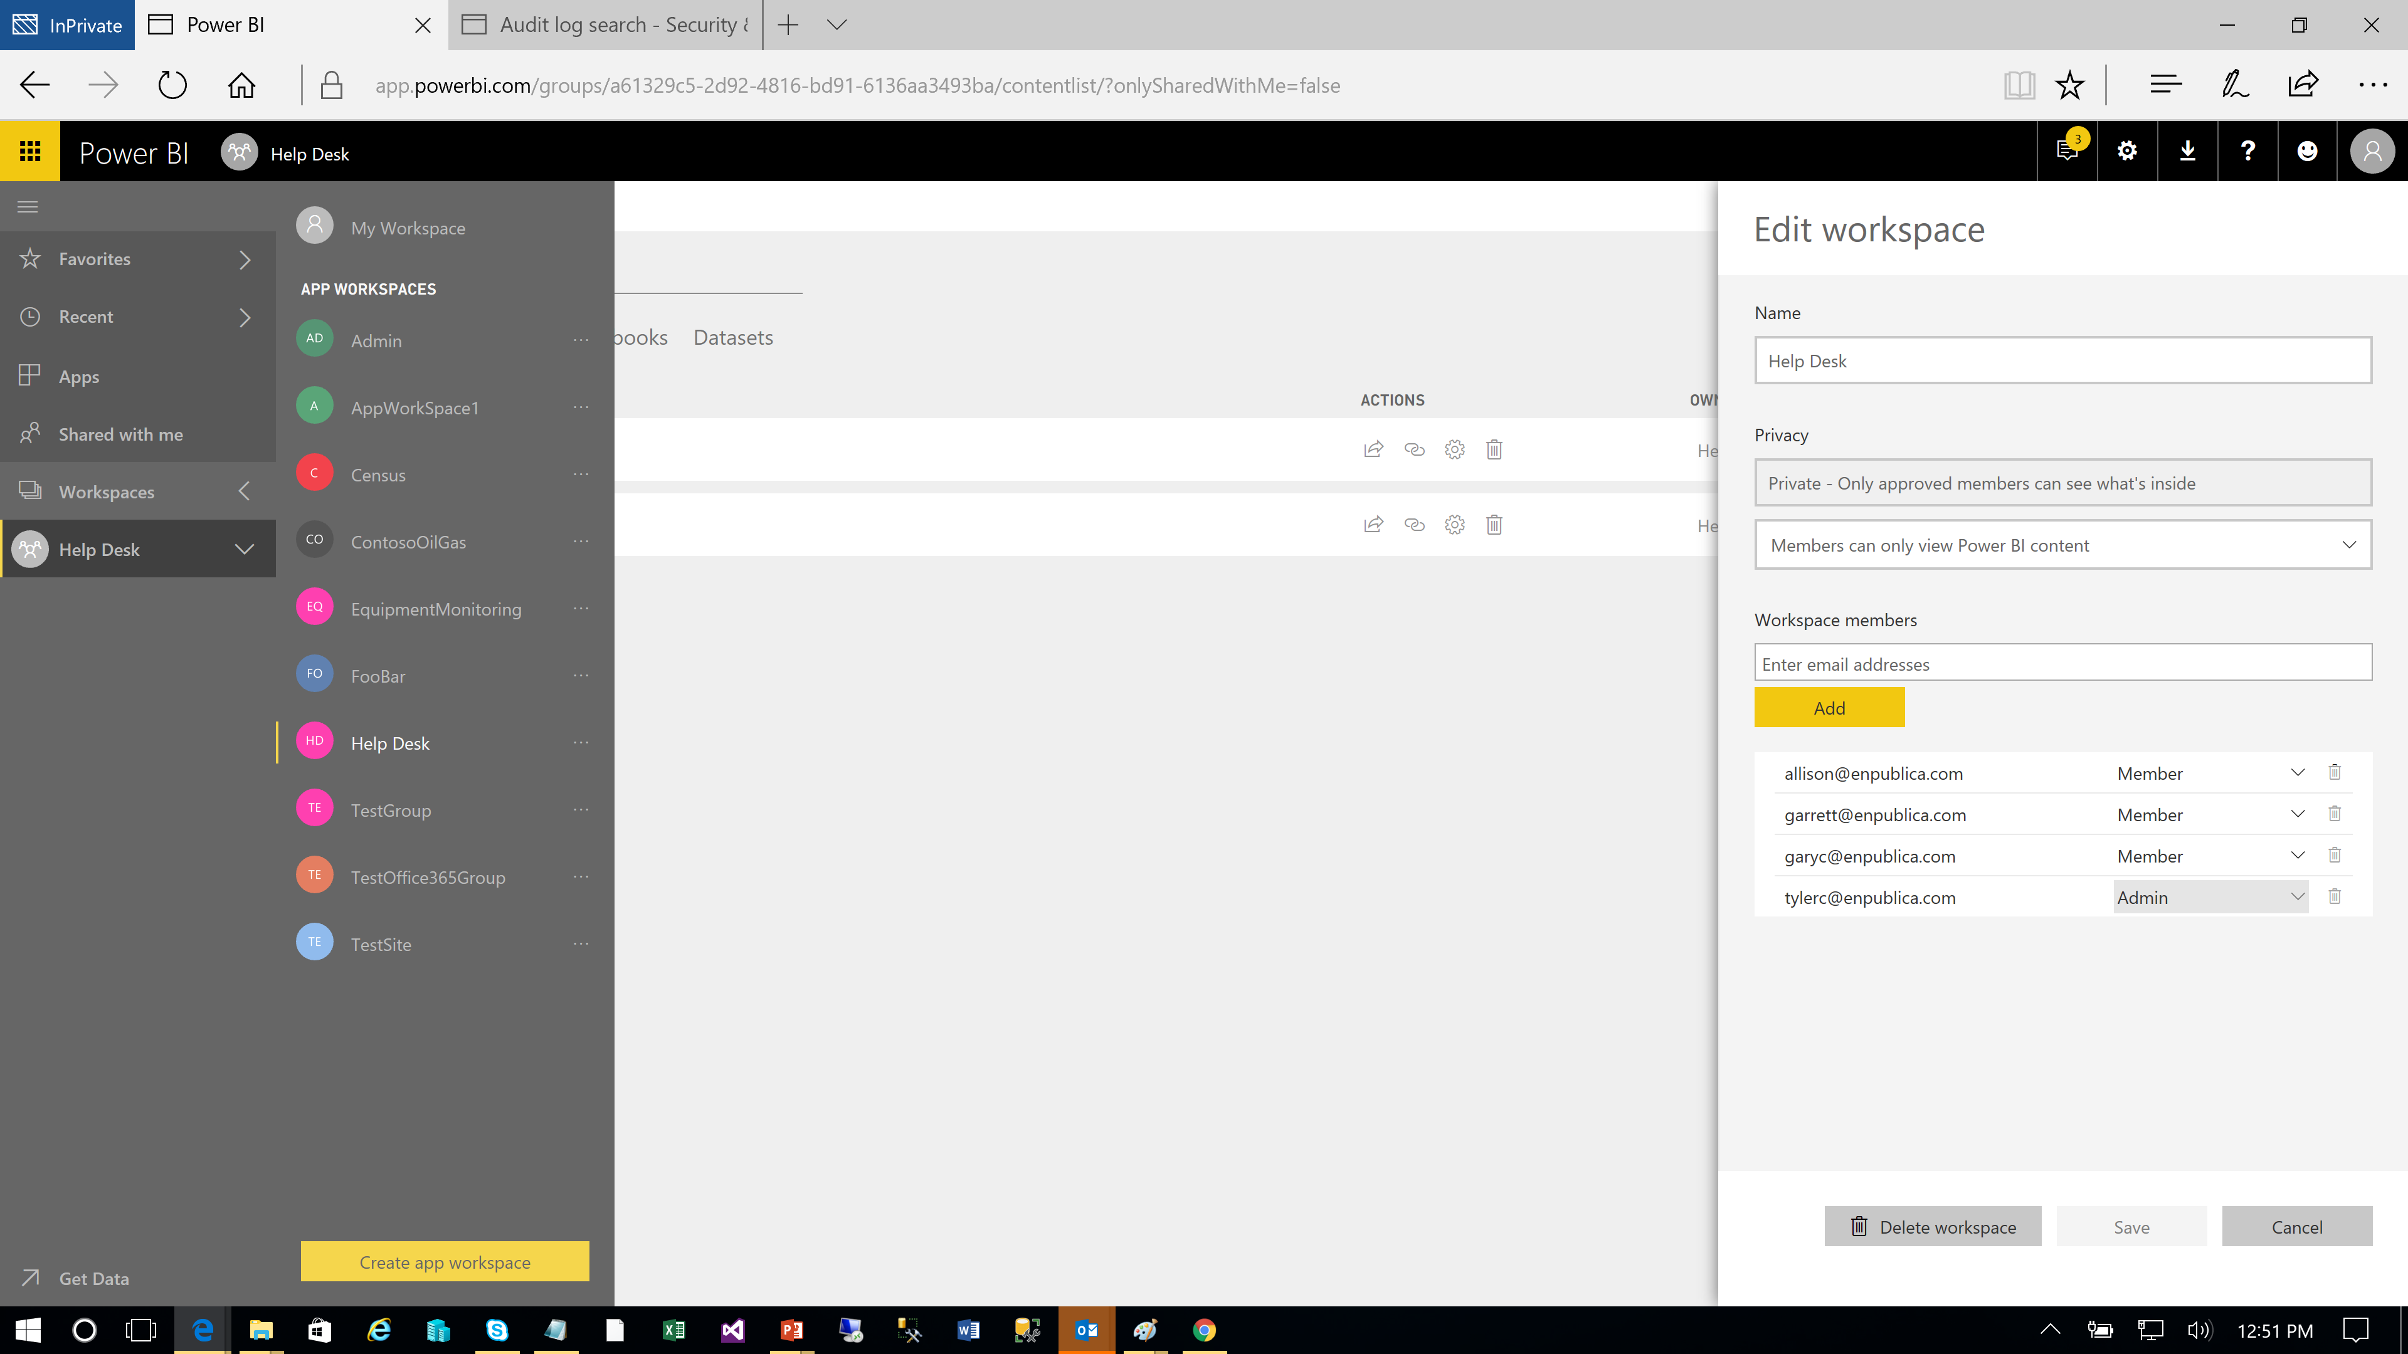
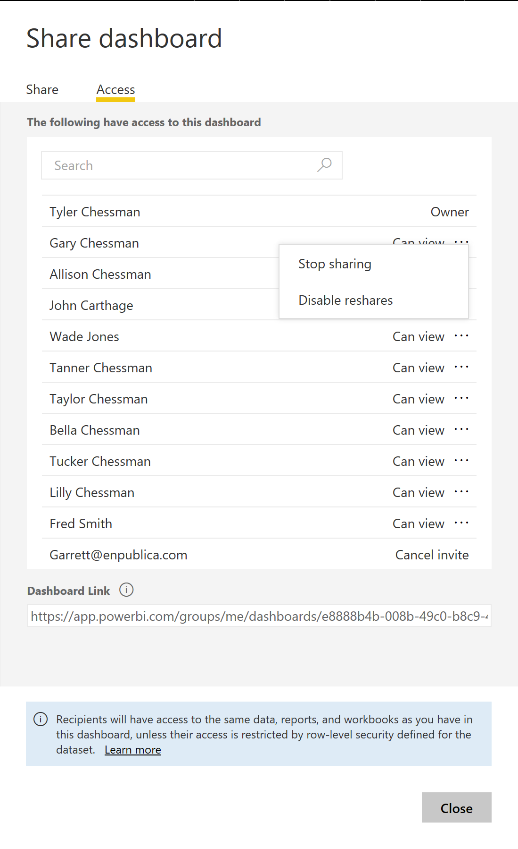
Publishing and Sharing Content Different Sharing Options
Power BI Champion
Power User
BI Practitioner
Share a Dashboard / (New - Share a Report)
Share via a list of email addresses (new – security groups)
Recommendation – Use Sparingly. Monitor for usage and choose different approach for larger audiences
Create an App Workspace
Add admins and members/contributors to a workspace; deploy content directly to the workspace – no “publishing” or explicit sharing necessary
Note – members can have read-only or edit rights
Publish a Content Pack
Still available – but we are encouraging App Publishing instead…
Apps are still a bit aspirational (not all capabilities available); a content pack may still be needed for some use cases
Publish an App*
Update (Mar 2018) – you can select what workspace content is included in an App (but currently only 1 App per workspace)
Read-only – cannot make changes/copies of a dashboard or report. But, as of Mar 2018, report filters are saved on a per-user basis
*Users can get your apps in a few different ways:
They can find and install your app from Microsoft AppSource
You can send them a direct link.
You can install it automatically in your coworkers' Power BI accounts if your Power BI administrator gives you permission.

Slide 26
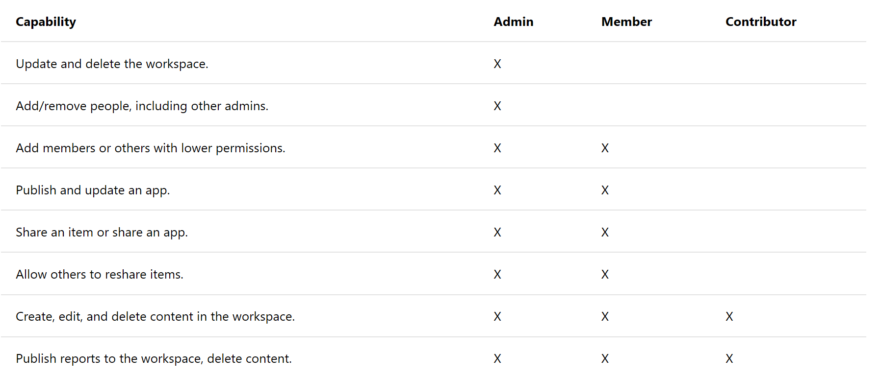
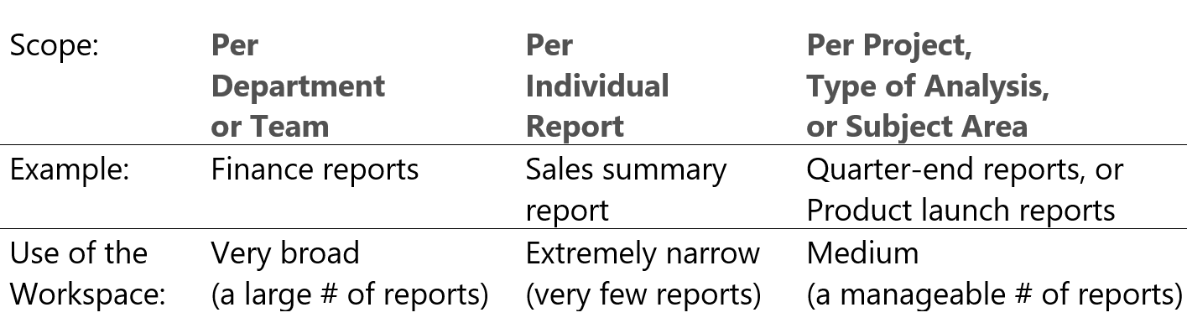
Publishing and Sharing Content V2 App Workspaces
Power BI Champion
Power User
BI Practitioner
As of April 2019, the “new workspace” experience is available in Power BI
Assign workspace roles to user groups: security groups, distribution lists, Office 365 groups, and individuals.
Create a workspace in Power BI without creating an Office 365 group.
Use more granular workspaces roles for more flexible permissions management in a workspace.
Plan to use the new workspaces when possible (see existing limitations per the URL below)
New Workspace roles →
What should a workspace contain? A few ideas…**
New Workspace roles*
*Viewer role to be added later (read-only access)
**pg 107, Enterprise Deployment Whitepaper
https://docs.microsoft.com/en-us/power-bi/service-create-the-new-workspaces

Slide 27
Publishing and Sharing Content Use Case Recommendations
Power BI Champion
Power User
BI Practitioner
Use Case | Dashboard/Report Share | Workspace Membership | Content Pack | App
Share a “read-only” view with small team | Use Sparingly | Yes (first create an App workspace*) | No Longer Available | Yes (first create an App workspace)
Share a “read-only” view with a large audience e.g., everyone, a particular security group | No | No | -- | Yes
Developer/Project “shared space” | -- | Yes - but Remember Members with edit permission can overwrite one-another | -- | --
Share a view that can be customized/extended | No | Yes – but with overwrite caveat | -- | Not yet available**
*New App Workspaces generally available as of Apr 2019
** Shared datasets - https://docs.microsoft.com/en-us/business-applications-release-notes/october18/intelligence-platform/power-bi-service/shared-certified-datasets, https://docs.microsoft.com/en-us/power-bi/service-datasets-share

Slide 28
Data Refresh and Live Connections Overview
Power User
Power BI Admin
Data Steward
Recall – Power BI Desktop supports two operating modes
Import. Data is pulled down, compressed, and saved as part of the Power BI Desktop file (.pbix).
Note – Excel PowerPivot workbooks and Service Packs are also imported models
Create a Live Connection (DirectQuery / Connect Live) . A connection to 1 (and only 1) data source (composite mode in preview as of Nov 2018)
After the .pbix file is published into the Power BI Service….
Basic workflow for supporting Data refresh and Live Connections
Power BI Administrator installs an on-premise data gateway on a server/virtual machine within the corporate datacenter; he “registers” the gateway with the Power BI Service using a Power BI Pro account
Note - multiple gateways can be installed; each gateway can support 1-to-many back-end data sources
The Power BI Administrator (from the Power BI console) adds 1 or more data sources to the gateway; he adds users/groups who will be allowed to use this gateway for refresh or live connections
The Power User publishes .pbix file to the Power BI Service; he specifies (for the dataset) a gateway to use for refresh/live connections
Mode | View in the Service | Schedule Refresh in the Service
Import | No further configuration needed | Personal or On-Premise Data Gateway required
Live Connection | On-Premise Data Gateway required | N/A

Slide 29
Data Sources Questions for Today….
Gateways
Security deep dive
Principal propagation for SSO
Use for cloud data sources (Azure SQL), when and why
XYZ wants to close ports for Azure SQL
Architecture discussion to include clustering, high availability, disaster recovery and operational excellence
SSO (single sign on) to data sources
XYZ puts all security at the DB layer
Need options/strategy for dealing with non SSO sources
How to do scheduled refresh from an Excel file (#1 use case)
XYZ does not use OneDrive or SharePoint Online
Azure architecture considerations for Azure data sources being consumed by Power BI.
Example: o365 DC is in Chicago does Azure need to in same DC for Azure SQL DB perf?
Notes:
Gateway and Cloud Source like Azure SQL DB –
https://azure.microsoft.com/en-us/blog/securing-the-connection-between-power-bi-and-azure-sql-database/
https://ideas.powerbi.com/forums/265200-power-bi-ideas/suggestions/37702114-powerbi-gateway-add-azure-sql-database-as-a-data

Slide 30
Data Sources Gateway / Use for cloud data sources (Azure SQL), when, and why
By default, the Gateway is not required to connect to cloud data sources, like SQL Azure
Azure SQL DB allows Firewall rules to restrict client IP access
The “allow access to Azure Services” option (On/Off) allows access from Azure Resources, including VMs
To further restrict Azure SQL DB access, Vnet service endpoints can be employed
Architecture discussion to include clustering, high availability, disaster recovery and operational excellence
By deselecting “allow access to Azure Services”, the Power BI Service can no longer connect to the database
The workaround is to use the on-premise data gateway on a VM residing within the Subnet
Note the restrictions on this approach
Must use the SQL Connector, and only basic authentication is supported
https://azure.microsoft.com/en-us/blog/securing-the-connection-between-power-bi-and-azure-sql-database/
Notes:
Gateway and Cloud Source like Azure SQL DB –
https://azure.microsoft.com/en-us/blog/securing-the-connection-between-power-bi-and-azure-sql-database/
https://ideas.powerbi.com/forums/265200-power-bi-ideas/suggestions/37702114-powerbi-gateway-add-azure-sql-database-as-a-data

Slide 31
Data Sources SSO (single sign on) to data sources
XYZ puts all security at the DB layer
Need options/strategy for dealing with non SSO sources
For imported models, DB layer security will not be leveraged; credentials are specified/stored per gateway data source
Consider the use of aliases when multiple credentials (to the same data source) are needed
For both imported & Direct Query models, RLS can be used to restrict data access for specific users/groups
Learn more at https://docs.microsoft.com/en-us/power-bi/service-admin-rls
.

Slide 32
Data Sources How to do scheduled refresh from an Excel file
Solution – Use On-Premise Data Gateway and an on-premise file share to host Excel files
Requirements
User first uploads files to a local file share (e.g., \\OurFileSource\Finance\...)
User builds PBI Desktop file with this file share as a source
Gateway admin adds file shares as a data source, and adds necessary Users who will be refreshing from this file share
User selects on-premise gateway (after publishing .pbix file) for refresh activity
DEMO
https://docs.microsoft.com/en-us/power-bi/refresh-scheduled-refresh

Slide 33
Data Sources Architecture considerations for Azure data sources being consumed by Power BI
Example: o365 DC is in Chicago does Azure need to in same DC for Azure SQL DB perf?
Imported Models
Performance is only applicable during refresh activity, may not be much of a factor. Note that data egress charges will apply
Direct Query / Live Connection Models
Performance hit will be additional network latency of going between Azure Data Centers (note that data egress charges apply)
https://azure.microsoft.com/en-us/blog/how-microsoft-builds-its-fast-and-reliable-global-network/
https://blogs.msdn.microsoft.com/mioteg/2017/11/20/measuring-latency-and-throughput-between-azure-regions/
https://azure.microsoft.com/en-us/pricing/details/bandwidth

Slide 34
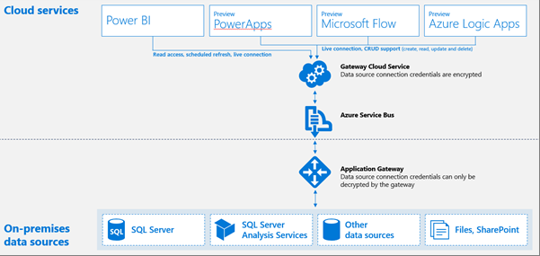
The On-Premises Data Gateway Overview
The on-premises data gateway acts as a bridge, providing quick and secure data transfer between on-premises data (data that is not in the cloud) and the Power BI, Microsoft Flow, Logic Apps, and PowerApps services.
Two different gateway modes
On-premises data gateway: multiple users can share and reuse a gateway; can be used by Power BI, PowerApps, Flow or Logic Apps. For Power BI, this includes support for schedule refresh & DirectQuery
Personal: for Power BI only and can be used as an individual without any administrator configuration*. This can only be used for on-demand refresh and schedule refresh.
*The on-premise gateway installs as a service. Personal gateway will install as a service or, without admin rights, an application
https://powerbi.microsoft.com/en-us/documentation/powerbi-gateway-onprem/

Slide 35
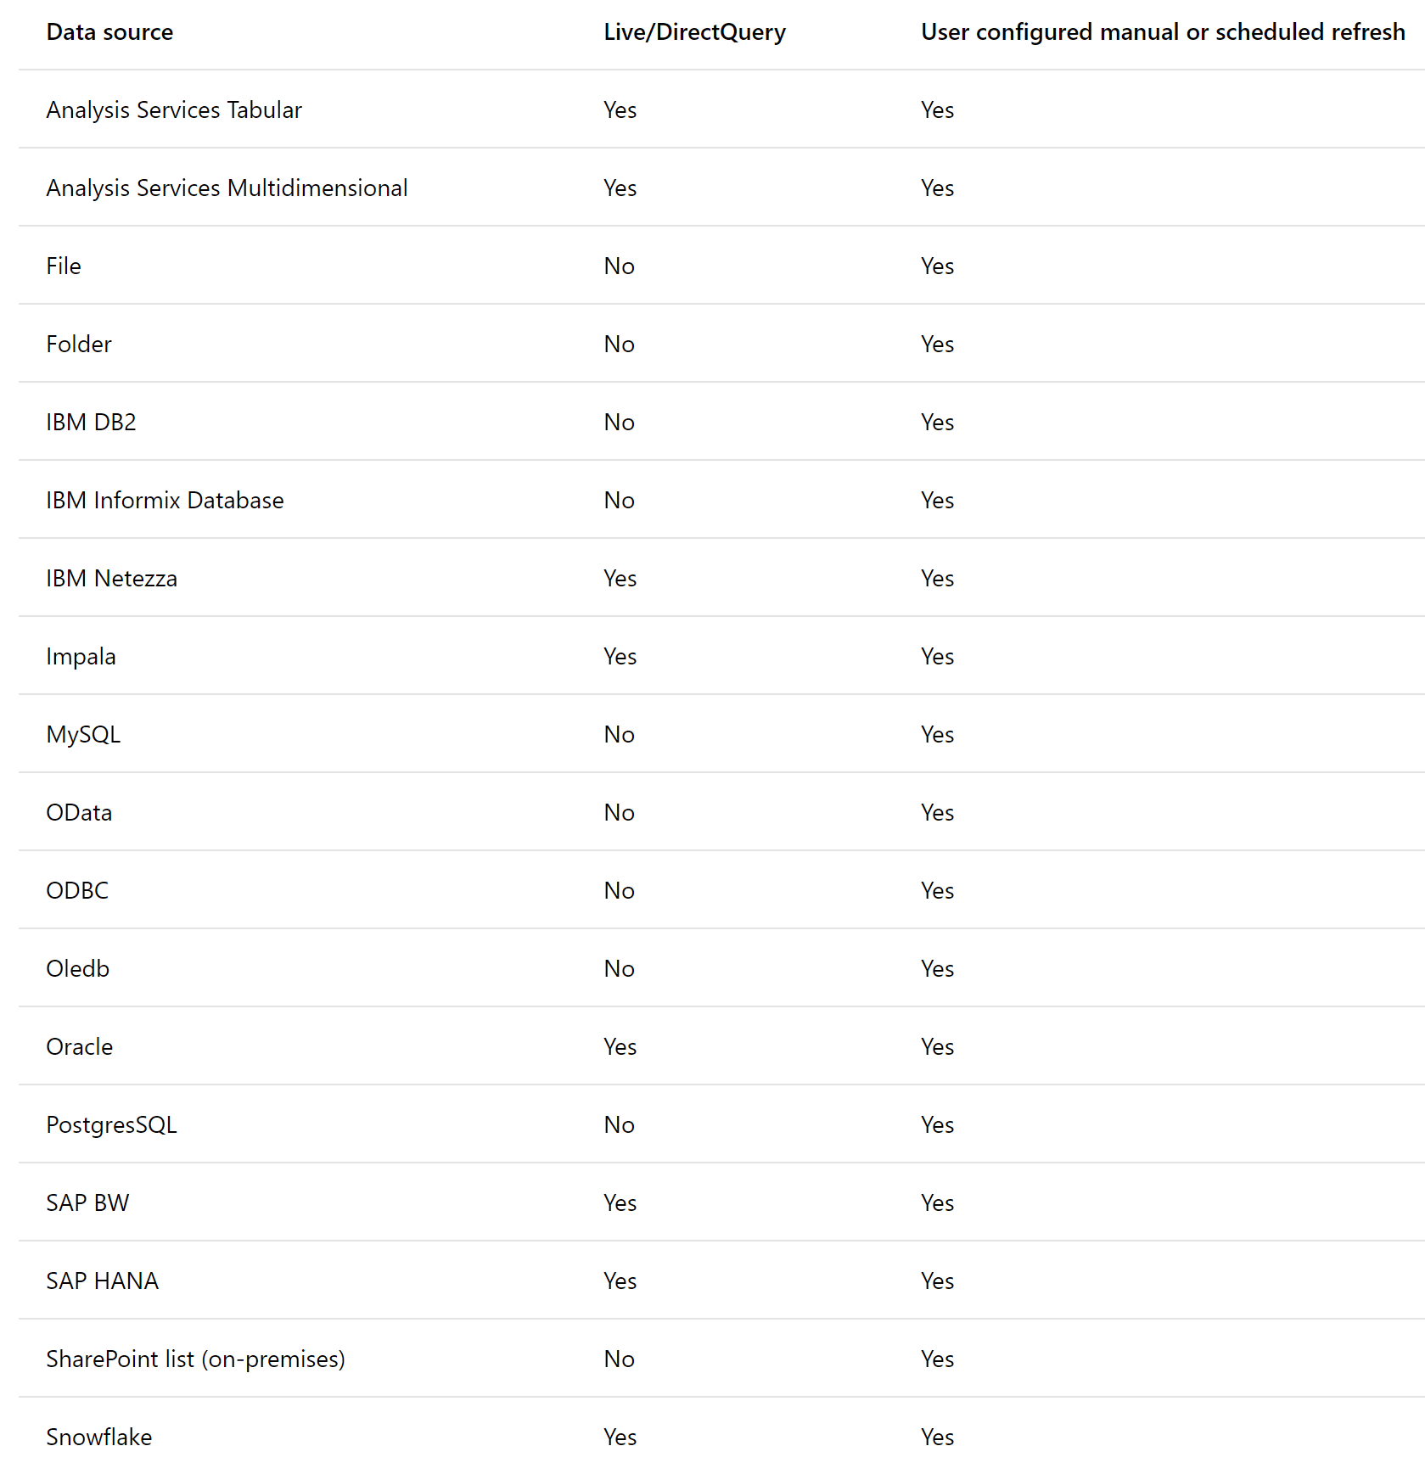
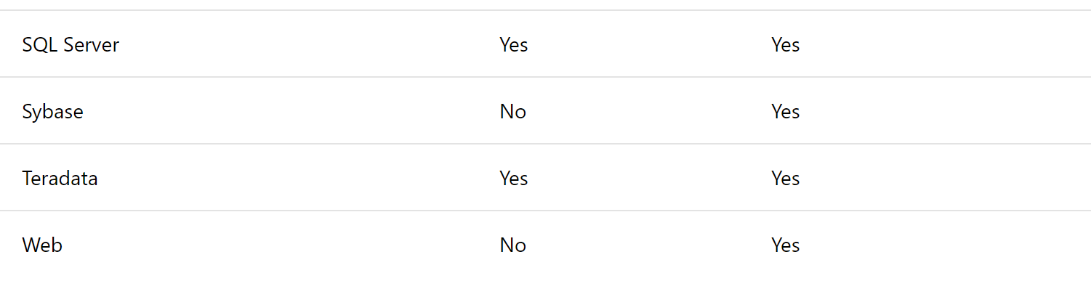
Keeping data current in Power BI
On-Premises Data Gateway
IT can install the On-Premises Data Gateway to serve large groups of users to refresh supported on-premises data sources
IT can:
Centrally manage the set of users who have access to the underlying data sources
Gain visibility into gateway usage, such as most commonly accessed data sources, and the users accessing them
Ports. The gateway creates an outbound connection to Azure Service Bus. It communicates on outbound ports: TCP 443 (default), 5671, 5672, 9350 thru 9354. The gateway does not require inbound ports.
https://docs.microsoft.com/en-us/power-bi/service-gateway-custom-connectors
Notes:
Power BI Knowledgebase: https://powerbi.microsoft.com/en-us/documentation/powerbi-gateway-enterprise/

Slide 36
How the Gateway works
.
What happens when a user interacts with an element connected to an on-premises data source -
A query will be created by the cloud service, along with the encrypted credentials for the on-premises data source, and sent to the queue for the gateway to process.
The gateway cloud service will analyze the query and will push the request to the Azure Service Bus.
The on-premises data gateway polls the Azure Service Bus for pending requests.
The gateway gets the query, decrypts the credentials and connects to the data source(s) with those credentials.
The gateway sends the query to the data source for execution.
The results are sent from the data source, back to the gateway, and then onto the cloud service. The service then uses the results.
https://powerbi.microsoft.com/en-us/documentation/powerbi-gateway-onprem-indepth/
Notes:
Power BI Knowledgebase: https://powerbi.microsoft.com/en-us/documentation/powerbi-gateway-enterprise/

Slide 37
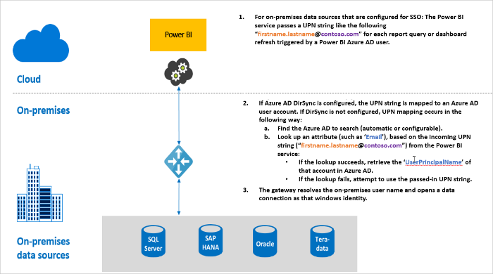
The On-Premises Data Gateway SSO
SSO is currently supported (for DirectQuery*) for the following data sources –
SQL Server (Kerberos)
SAP HANA (Kerberos and SAML)
SAP BW (Kerberos)
Teradata (Kerberos)
Spark (Kerberos)
Impala (Kerberos)
Query Steps when running SSO
For each query, the Power BI service includes the user principal name (UPN) when sending a query request to the configured gateway.
The gateway needs to map the Azure Active Directory UPN to a local Active Directory identity.
If Azure AD DirSync (also known as Azure AD Connect) is configured, then the mapping works automatically in the gateway.
Otherwise, the gateway can look up and map the Azure AD UPN to a local user by performing a lookup against the local Active Directory domain.
The gateway service process impersonates the mapped local user, opens the connection to the underlying database, and sends the query.
* Live Connections to SSAS use impersonation via EffectiveUserName
https://docs.microsoft.com/en-us/power-bi/service-gateway-sso-overview

Slide 38
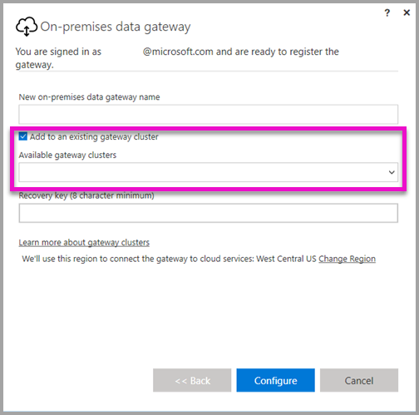
Gateway Management/Monitoring
Management
Today, anyone with a Pro license can install a gateway.
Consider organization policies to monitor/prevent unwanted installations
Audit logs can also monitor gateway events
Consider a “shared” Power BI Pro Account (e.g., “GatewayAdmin”) to configure/register a Gateway (the gateway is tied to a single Pro Account – though multiple admins can be added to the gateway)
New – Power Platform Admin Center to see full list of gateways installed.
Monitoring
The Gateway can be monitored via Service availability/Performance Counters
The following link details an approach and considerations in monitoring the On-Premises Data Gateway - https://insightsquest.com/2016/08/08/monitor-on-premises-data-gateways/
New - https://docs.microsoft.com/en-us/power-bi/service-gateway-performance-monitoring
High Availability
(Dec 2017) - High availability with active/passive configuration now available (load-balancing is now available as well) - https://docs.microsoft.com/en-us/power-bi/service-gateway-high-availability-clusters
(Older) Alternative, use a recovery key for a smooth take-over scenario
Install a gateway on the first machine, configure, and note the recovery key
Install a gateway on a 2nd machine – but don’t configure
Choose “Migrate, restore, or takeover an existing gateway” option
Notes:
Power BI Knowledgebase: https://powerbi.microsoft.com/en-us/documentation/powerbi-gateway-enterprise/

Slide 39
DEMO On Premise Data Gateway

Slide 40
Lifecycle Management Moving from Dev to Test to Production
Power BI Champion
Power User
BI Practitioner
Assumption – You are using an App for “deployment to the masses”
App is deployed within a workspace with a small set of Admins/Members; Admins are responsible for member management and app publishing.
Members are the developers and/or power users who participate in creating/maintaining/validating content
Option 1 – One Workspace
Use the “Included in App” capability to include/exclude items from App (dashboards/reports)
Changes to “included” dashboards/reports are not visible to the App until the App is updated (re-published)
Note that “breaking changes” – e.g., removing/renaming a dataset table field, are reflected immediately (i.e. no dataset versioning)
Option 2 – Multiple Workspaces
Note that you can still use the “Included in App” capability to include/exclude items from App (dashboards/reports)
But now, initial creation of content and changes to existing content (including datasets, reports, and dashboards) is done in a workspace that is independent of the “Production” workspace
Migration of content from workspaces can be done manually or via scripts (Power BI Rest APIs) e.g., https://powerbi.microsoft.com/en-us/blog/duplicate-workspaces-using-the-power-bi-rest-apis-a-step-by-step-tutorial/
Datasets can also be updated to point to a different data source via script
Option 3 (Coming Soon) – Deployment Pipelines
https://docs.microsoft.com/en-us/power-platform-release-plan/2020wave1/business-intelligence/deployment-pipeline--develop-test-deploy-workspace-content
https://docs.microsoft.com/en-us/rest/api/power-bi/

Slide 41
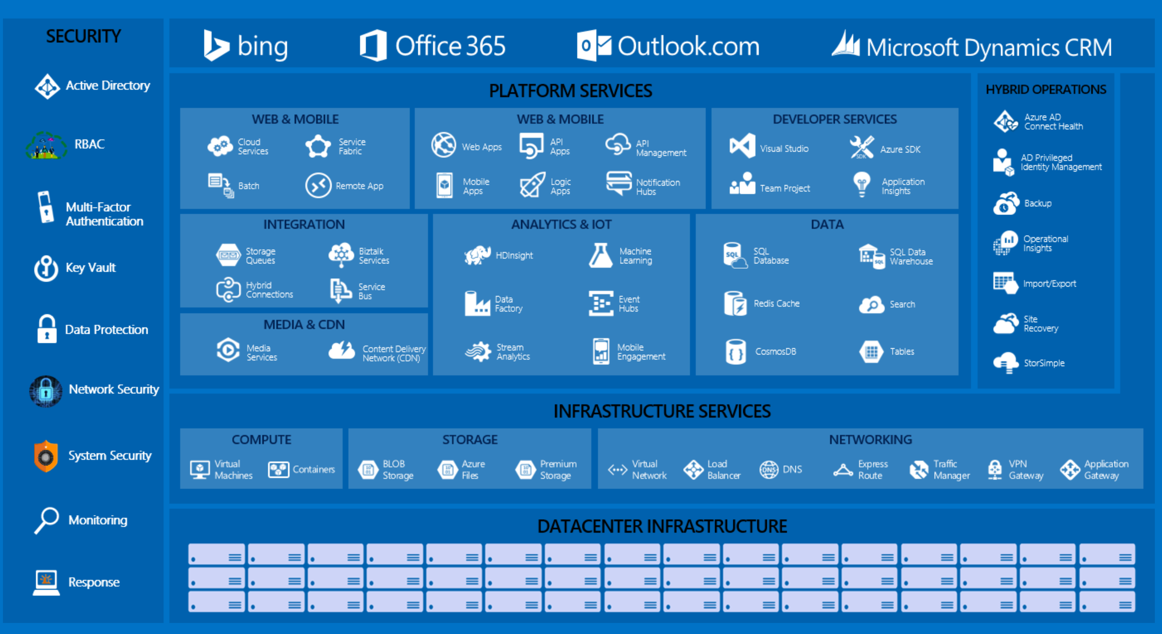

Slide 42
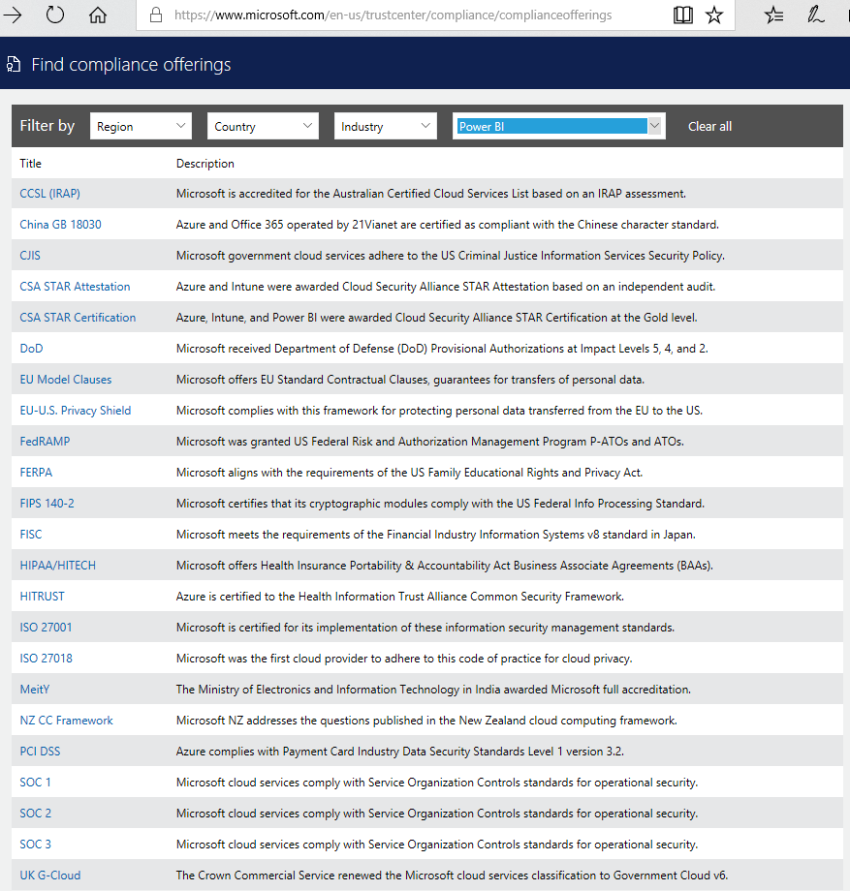


Power BI Security Agenda
User Identity (Authentication)
Data Security
Collaboration within your organization
Collaboration outside of your organization
4
1
3
10101101011010110101101011010110101101011010110101101011010110101101011010110101101011010110
2
https://www.microsoft.com/en-us/trustcenter/Compliance/default.aspx

Slide 43
Power BI Security User Identity (Authentication)
Power BI is part of the larger Microsoft cloud
Like other cloud services, PBI leverages Azure Active Directory (AAD)
AAD is the default authentication mechanism for PBI
Other authentication approaches can be used for Embedded scenarios
AAD setup and configuration is a key building block for PBI
Most large organizations will synchronize their on-premise Active Directory with AAD
Advanced authentication requirements (e.g., multi-factor) are supported in AAD
AAD is also used, and can be supplemented, for the PBI mobile devices (next slide)

Slide 44
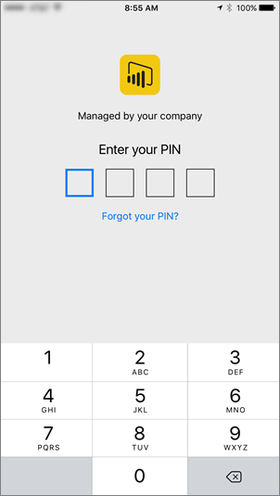
Power BI Security User Identity (Authentication)
Mobile Device/App Management:
Controlled via Intune for Power BI Mobile apps on iOS (7+) /Android (4+)
Policies such as:
Require PIN
Max failed PIN attempts
Configuring InTune:
Specify the app
Configure policies (i.e. require PIN)
Enable for deployment
End-users install from Company Portal app
https://powerbi.microsoft.com/en-us/documentation/powerbi-admin-mobile-intune/

Slide 45
Power BI Security Data Security - How Power BI handles data
Generally data is either In Process or At Rest
Data in transit between Power BI and data source is always encrypted via HTTPS
Depending on the data source, data may be stored in the service, or retrieved “just in time”…
Data Source | Metadata/Visual cache | Credentials | Data
Analysis Services (on-prem) | Nothing stored except reference to DB in Azure SQL, Encrypted | Stored in Azure SQL, Encrypted | Nothing stored at rest in Power BI service.
Direct Query | Stored in Azure BLOB storage, Encrypted | Model created in service: stored as part of connection string Imported from desktop: Stored in Azure SQL, Encrypted | Nothing stored at rest in Power BI service.
Pushed data (i.e. non-Direct Query, non-AS on-prem) | Stored in Azure BLOB storage, Encrypted | (Not applicable) | Push Data v1: Stored in Azure BLOB storage, Encrypted Push Data v2: Stored in Azure SQL, Encrypted
ETL/Cached data | Stored in Azure BLOB storage, Encrypted | Salesforce/OneDrive: refresh tokens stored in Azure SQL DB, Encrypted Refresh dataset: stored in Azure SQL DB, Encrypted Non-refresh dataset: No credentials stored | Stored in Azure BLOB storage, Encrypted

Slide 46
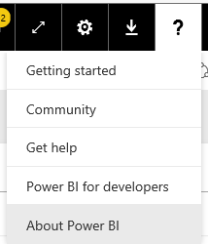
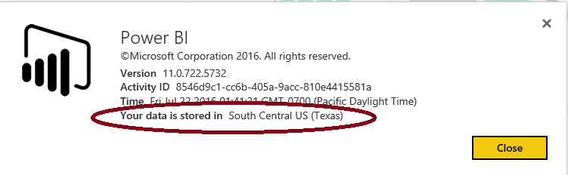
Power BI Security Date Storage & Encryption Keys
Where is my data stored?
The encryption keys….
to Azure Blob keys are stored, encrypted, in a separate location in the Power BI service.
for Azure SQL Database TDE technology is managed by Azure SQL itself.
for Data Movement service and on premises Gateway are stored:
On-prem data sources: In the on premises Gateway on customer’s infrastructure
Cloud-based data sources: In the Data Movement Role

Slide 47
Power BI Security Data Security: User Data Access
Data Access can be considered a subset of authorization (what you can do)
Some data access requirements can be handled with item-level sharing e.g.,
Share a dashboard or reports for read-only access with a user or group
Share a collection of dashboards/reports (via an App) with a user or group
Assign membership in a workspace (e.g., viewer, contributor, admin) to allow a user/group to view and/or modify dashboards/reports/datasets
Note: knowing whether an item has been shared/viewed/exported is handled via PBI monitoring capabilities (covered in subsequent slides)
Other use-cases require more granular data access rules e.g.,
We both can view a report - you can only see North America sales, & I should see South America; Fred the admin can see everything
This is referred to as row-level security (RLS) aka dynamic security

Slide 48
Power BI Security Data Security: RLS Overview
Imported datasets
RLS can be defined as part of the authoring/publishing process (next slide)
Direct Query datasets
RLS can be defined as part of the .pbix file (next slide)
RLS can alternatively by handled by an “RLS-enabled” data sources, which means…
The back-end data source implements some form of RLS
Power BI can pass (or impersonate) the user credentials when connecting to the data source (i.e. Single Sign On – SSO)
RLS-enabled data sources
Data presented is based on permissions of the user who is accessing the report/dashboard, etc.
SSO is available for several on-prem DirectQuery data sources (e.g., SQL Server, SAP Hana/BW, Oracle, Teradata, Spark, Impala) - https://docs.microsoft.com/en-us/power-bi/service-gateway-sso-overview
SSO is also available for some cloud-based sources (e.g., Azure SQL DB, Azure Synapse Analytics)

Slide 49
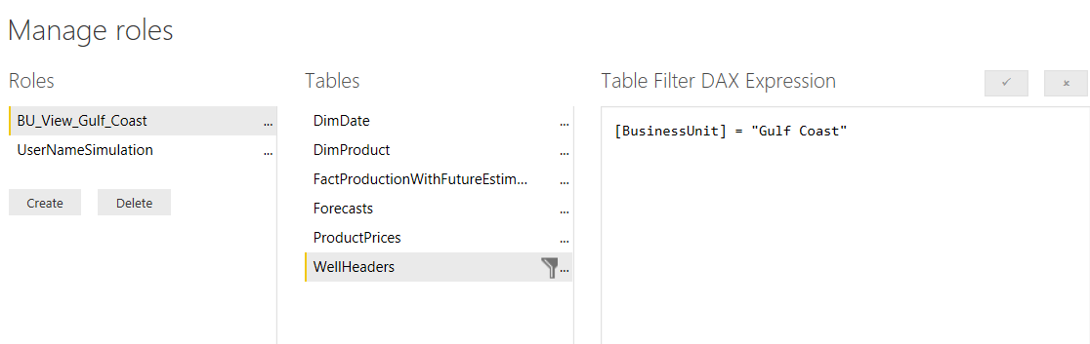
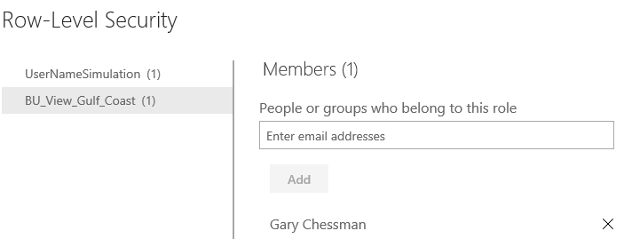
Power BI Security Row Level Security (RLS) for SSAS/PBI Datasets
SQL/Azure Analysis Services is a RLS-enabled data source
Analysis Services allows data to be secured based on a user’s Role, and via Row Filters (if configured)
Power BI can emit the username used to sign into the PBI service (UserPrincipalName) via Analysis Services’ EffectiveUserName option – which is used to impersonate the user and set role mappings/RLS
Role-Level Security is also available for an imported/direct query dataset
You configure Roles and define RLS for the dataset in The PBI Desktop
You then map users to roles within PowerBI.com (i.e. after the Desktop file has been published)
Note: be aware of performance implications for direct query datasets (additional filter on each query)
Define Roles in the Desktop
Map Users in the Service

Slide 50
Power BI Security Collaboration within your organization
Scopes of control
User
Groups
My Organization
Think about which scope is right for
managing access when collaborating
Ways to control collaboration
Power BI Workspaces
Apps
Sharing (i.e. sharing a dashboard/reports via Email/Distribution Lists/Groups)
My Organization
Groups
User

Slide 51
Power BI Security Collaboration outsides of your organization
You can share dashboards/reports with people outside your organization via email with a link to the shared dashboard/report
The recipient has to sign-in to Power BI to see the dashboard/reports
If they don't have a Power BI account, they can create one after clicking the link
External sharing can be turned off by the tenant admin
Note – you can also expose a report for anonymous access (publish to web)
This can also be turned on/off by the tenant admin
Update (Feb 2018) – Power BI now integrates with Azure AD B2B
Allows distribution of Power BI content to guest users outside of the org
Three licensing options – Power BI Premium, Assign Pro license to guest user, or guest user brings their own Power BI Pro license
https://docs.microsoft.com/en-us/power-bi/service-admin-azure-ad-b2b

Slide 52
Power BI Security Resources
Security whitepaper
Row Level Security
Power BI Documentation
Microsoft Trust Center- Power BI
Data Sovereignty
Power BI Community

Slide 53
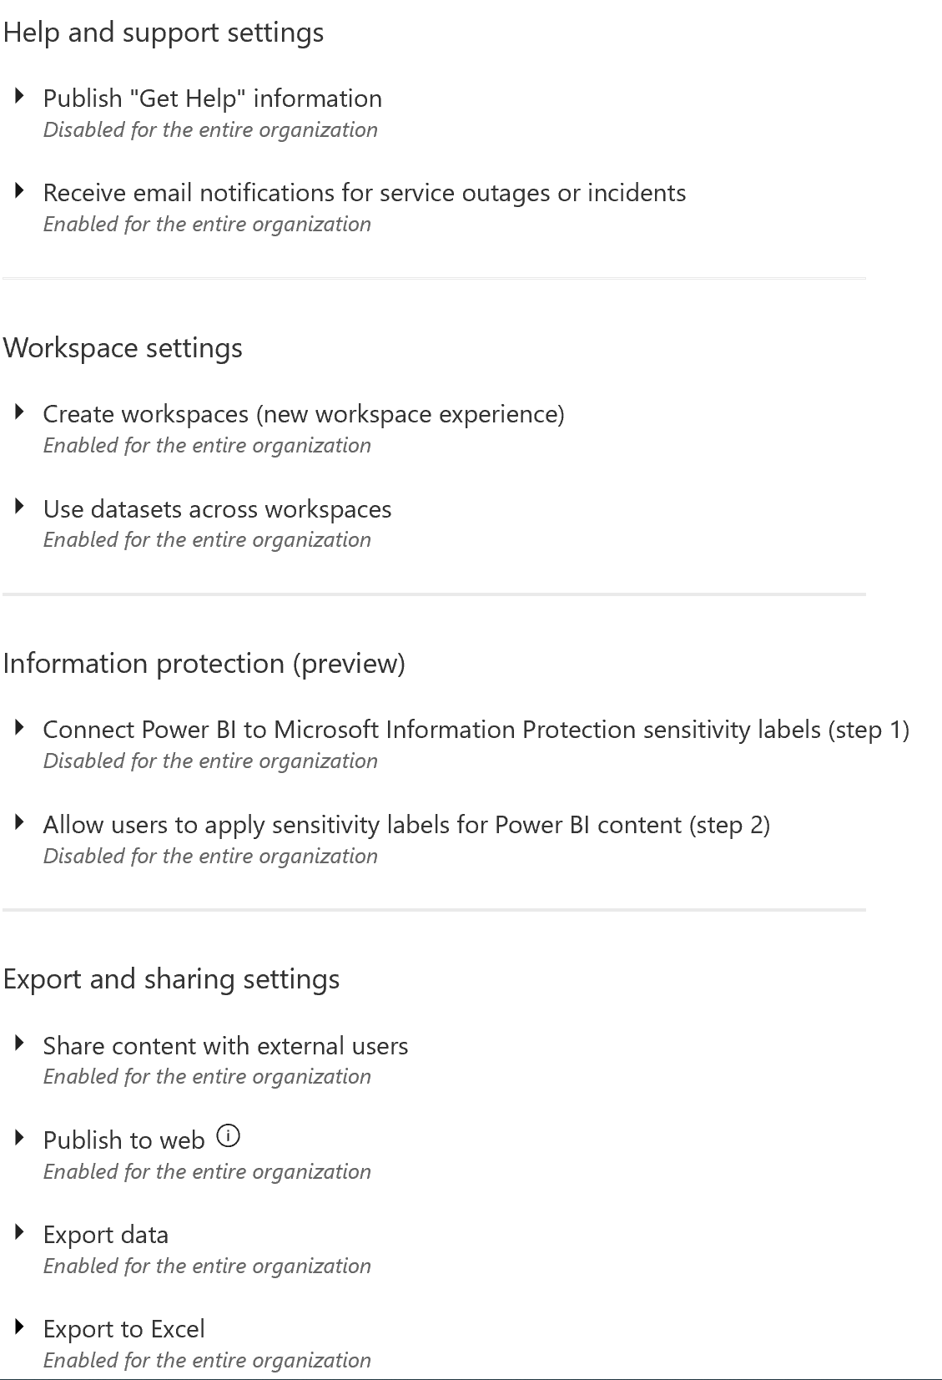
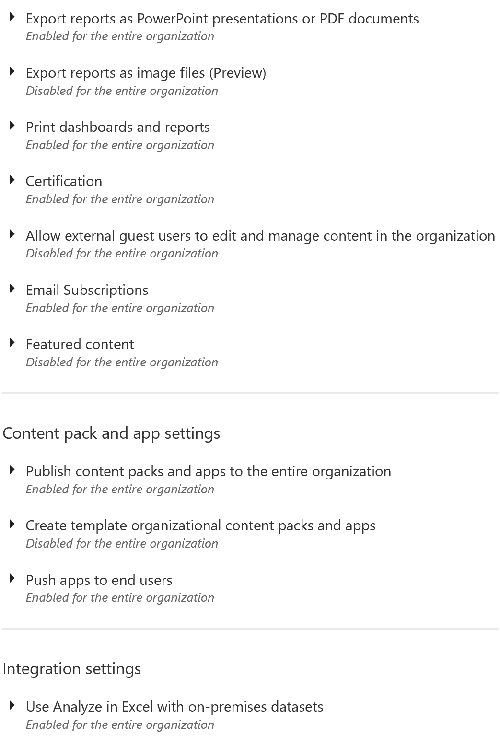
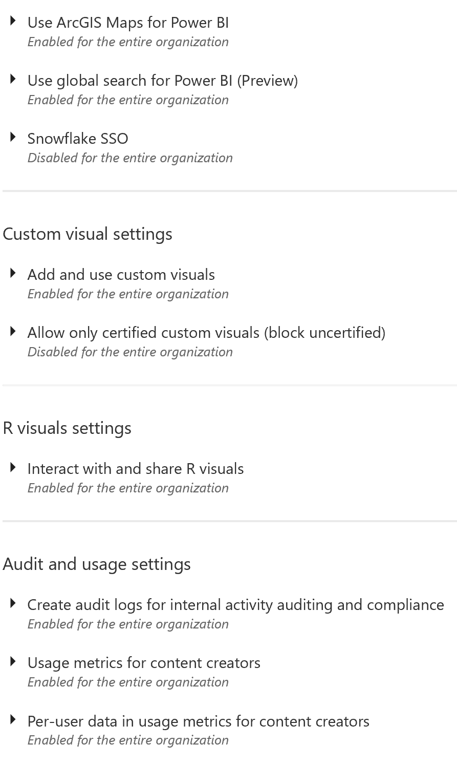
Power BI Tenant-Level Settings .

Slide 54
DEMO Adjusting Tenant Level Settings

Slide 55
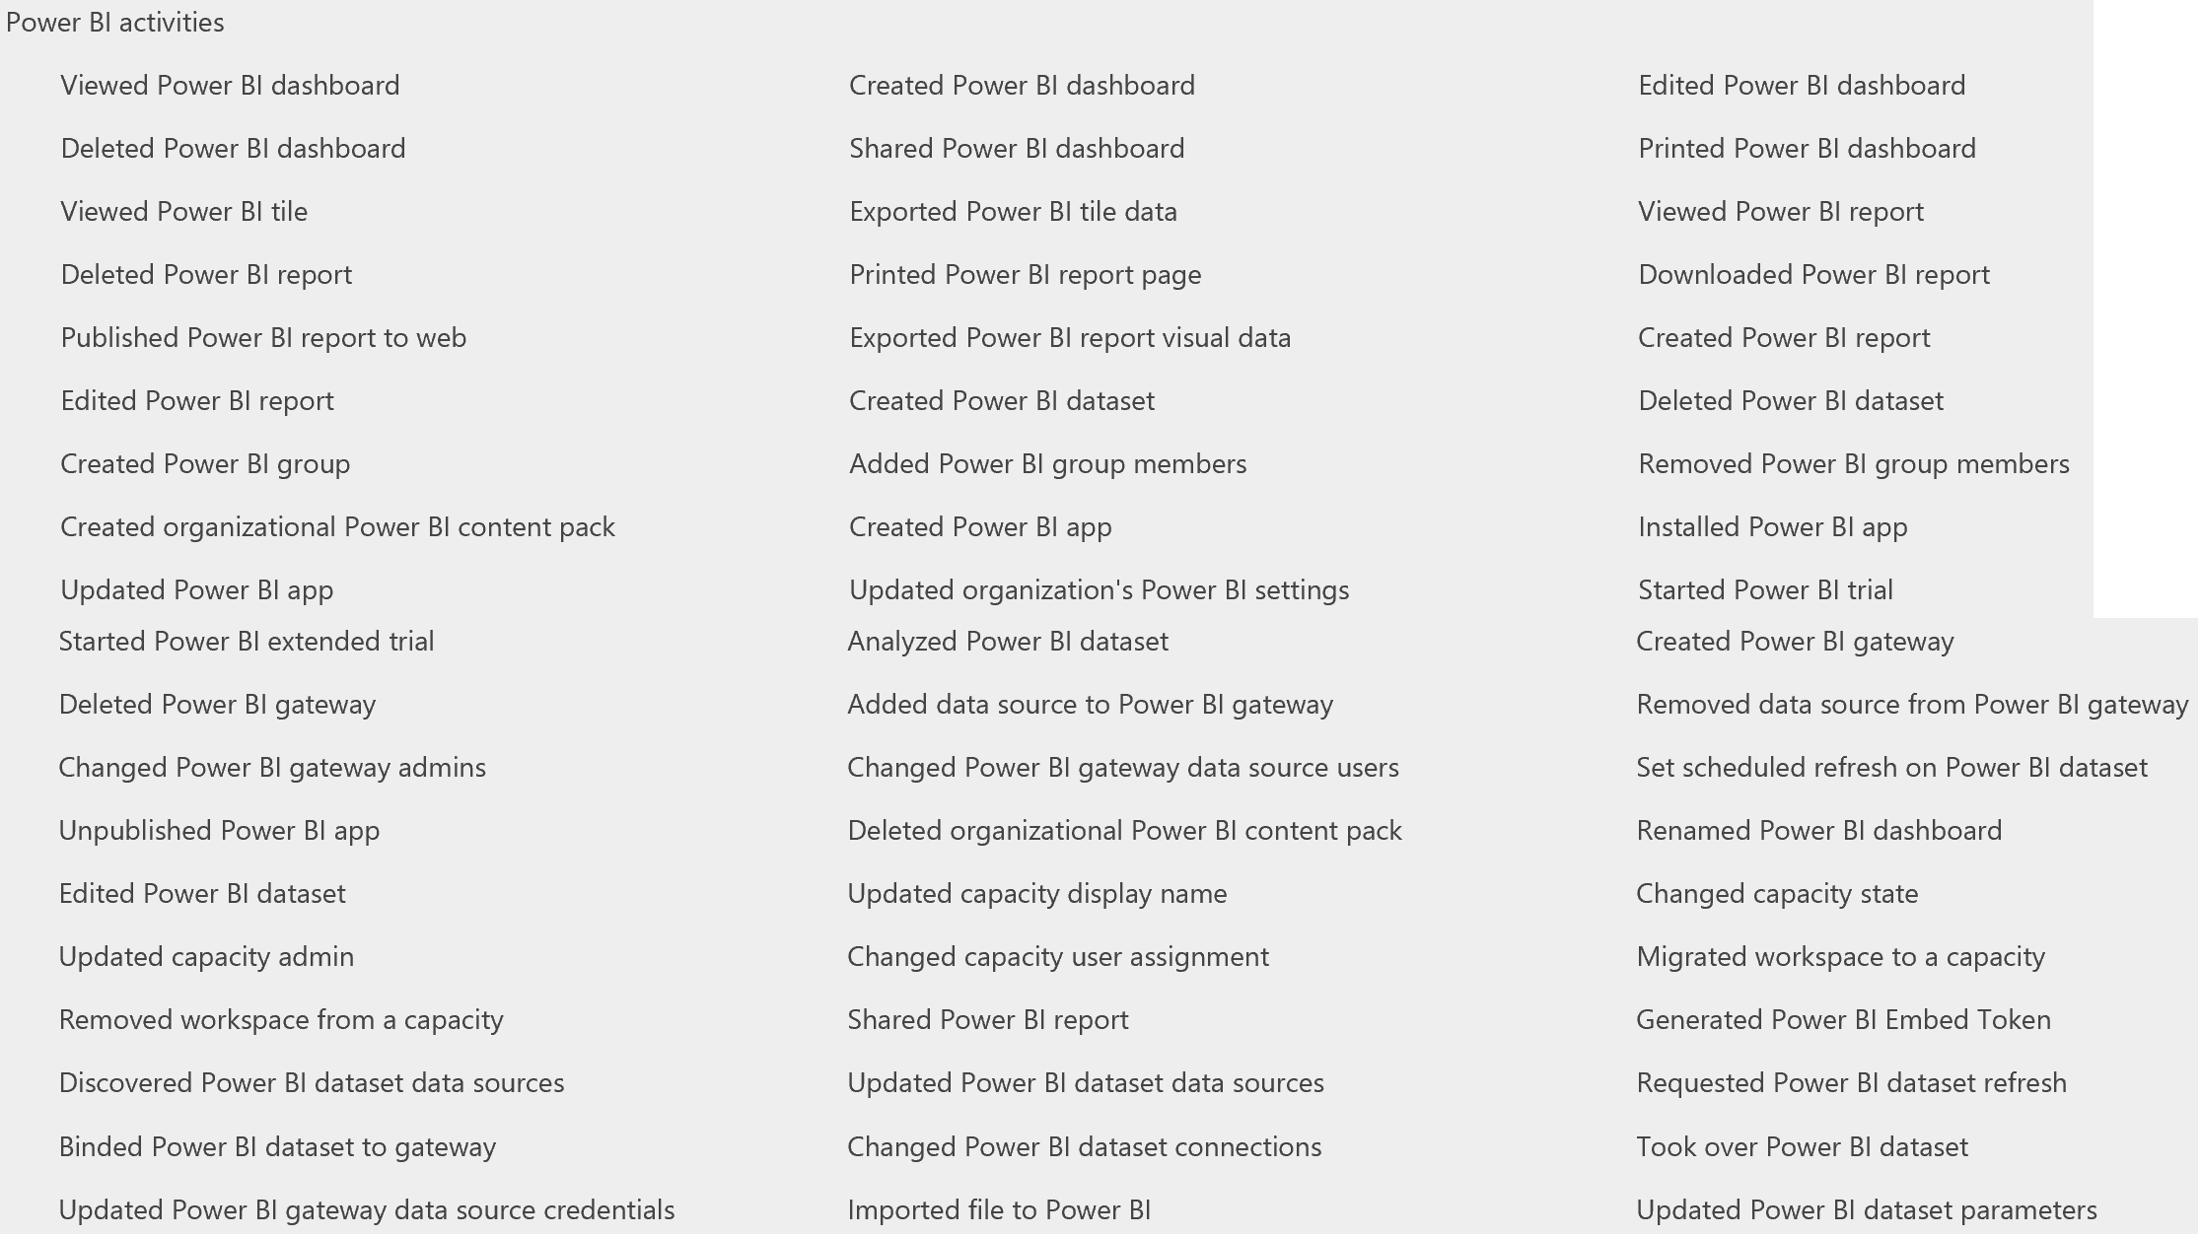
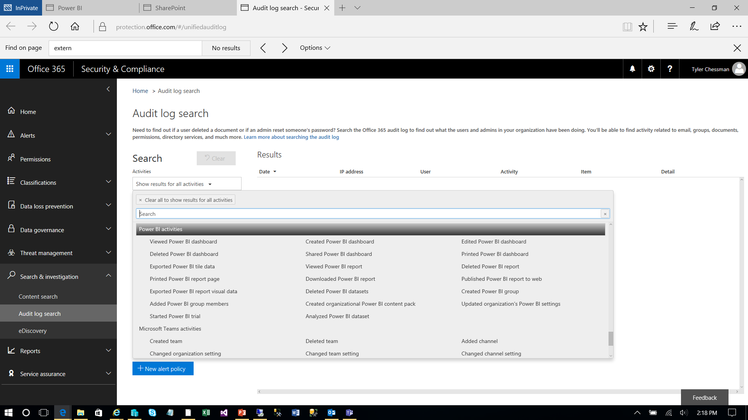



Monitoring and Auditing Overview
Power BI Champion
Power BI Admin
Security Architect
Basic “Usage Metrics” in the admin portal – ignore
Metrics can be generated at a workspace level
Optionally, a Tenant Level Setting (“Audit and usage settings”) can be configured
“Power BI will start logging various activities that your users perform in Power BI. The logs take up to 48 hours to show up in the O365 Security & Compliance Center.”
From the “Audit logs” section, you can then navigate to the Office 365 Admin Center (Audit Log Search) to query the logs
Feb 2018 – a Coworker example/template that automates the log extraction and provides base reports - angryanalytics.com/
Note – You can assign audit log privileges to non-admin accounts
Update – Feb 2018
The Office 365 Admin APIs can now be used in lieu of the Audit logs. Does not require audit and usage setting to be marked in Power BI, but still requires O365 Admin tenant privileges. 7-day retention, so important to extract/load.
Pre-configured partner solution available - https://powerbi.microsoft.com/en-us/blog/announcing-the-power-bi-usage-metrics-solution-template/
Update – Aug 2018
New Monitoring capabilities for Power BI Premium Capacities - https://powerbi.microsoft.com/en-us/blog/new-monitoring-capabilities-for-power-bi-premium-capacities/
Update – Dec 2019 – Power BI Audit logs as alternate to the usage logs
https://powerbi.microsoft.com/en-us/documentation/powerbi-admin-auditing/

Slide 56
DEMO Custom Solution – Power BI Audit Logs

Slide 57





Power BI Premium Management Basics
Power BI Admin
After purchasing a Power BI Premium subscription, the tenant receives a corresponding number of v-cores to assign to capacities (“v-core pooling) E.g.,
A P1 subscription provides 8 v-cores to create a single P1 capacity
A P3 subscription can be used to create one, or up to four (4 x P1) capacities
Multi-Geo support is now available
Cannot be changed after the capacity is created.
Role of the Capacity Admin
Assign workspaces to the capacity
Manage user permissions, to add additional Capacity Admins or users with assignment privileges (i.e. enable them to assign a workspace to the capacity)
Manage workloads (configure max memory usage) / Restart capacity
Capacity Workloads
The services made available to user (see here)
Memory and other settings can be used to bound performance
Assigning a Workspace to a Capacity
This is done during/after the setup of a workspace
Workspace admin needs assignment privilege to set this configuration
https://docs.microsoft.com/en-us/power-bi/service-premium-what-is

Slide 58





Power BI Premium Monitoring Basics
Power BI Admin
Monitoring is available in both the portal, and via the Power BI Premium Capacity Metrics app
Portal provides a quick view with high-level metrics (currently for the last 7 days)
The App provides more in-depth info (currently for the last 7 days)
Using the Capacity Metrics app
Can be installed from the Apps (Get Apps – Apps – Power BI
Refreshed automatically, with rolling 7-day history (may want to consider use of a subscription to review older data)
High-level dashboard provides summary statistics, with ability to drill down into detailed report
Tip – Keep a close watch on Memory usage, specifically overall memory consumption
May 2020
New Alerts for Premium Capacity Overload events - https://powerbi.microsoft.com/en-us/blog/announcing-timely-premium-capacity-overload-alerts/
https://docs.microsoft.com/en-us/power-bi/service-admin-premium-monitor-portal

Slide 59

Power BI Premium Capacity Planning, Testing, and Optimization
Power BI Admin
Capacity Planning
Blog post here – with links to useful resources
See Resource/Limits here
Testing
In addition to the testing tools (mentioned in above links), use of an A SKU is a good way to quickly and economically spin up a test environment
Optimization
TODO
https://docs.microsoft.com/en-us/power-bi/admin/service-premium-what-is

Slide 60
DEMO Monitoring Power BI Usage

Slide 61


Power BI Paginated Reports Getting Started
Reports are authored in the Power BI Report Builder*
Visual Studio can also be used to author reports – be aware of feature support differences (next slide)
Basics of building a report….
Create one or more data sources (e.g., SQL Server, Oracle)
Create one or more datasets (queries against a data source)
Optional – define parameter(s)
Design Report Layout
Preview Report
Publish
Monitor
Note - Reports are saved in the SSRS .rdl format
*Free download - https://www.microsoft.com/en-us/download/details.aspx?id=58158

Slide 62
Power BI Paginated Reports Data Source & Feature Support
Supported Data Sources
Power BI Datasets (via single sign-on (SSO))
Azure Analysis Services (via single sign on (SSO) and oAuth)
Azure SQL Data Warehouse
Azure SQL Database (username/password, SSO and oAuth)
Azure SQL Managed Instance via Public Endpoint (username/password)
SQL Server*
SQL Server Analysis Services (SSAS) tabular (DAX) and multidimensional (MDX) models*
Oracle*
Teradata*
*requires the on-premises Gateway.
SSRS features not yet available
Shared data sources (workaround – inline data sources)
Shared datasets
Subreports
Drillthrough and click-through to other reports
Linked reports
Data-driven subscriptions
https://docs.microsoft.com/en-us/power-bi/paginated-reports/paginated-reports-report-builder-power-bi#limitations-and-considerations
Notes:
https://docs.microsoft.com/en-us/power-bi/report-builder-url-parameters
https://powerbi.microsoft.com/en-us/blog/power-bi-open-platform-connectivity-with-xmla-endpoints-public-preview/
https://app.powerbi.com/groups/ab897796-4f8a-46bc-a309-28ac5c1aaa46/rdlreports/eee87ade-24a2-430c-8941-b12c8baf46ab?rp:ReportID=3a8a4fc4-0a29-481e-8108-7ecbe1648b53&rp:TimeStart=12/01/2014
https://app.powerbi.com/rdlEmbed?reportId=eee87ade-24a2-430c-8941-b12c8baf46ab&autoAuth=true&rp:ReportID=3a8a4fc4-0a29-481e-8108-7ecbe1648b53&rp:TimeStart=12/01/2014

Slide 63
DEMO Design Paginated Reports

Slide 64



Power BI Paginated Reports Publishing
From Report Builder, reports can be directly published to the Service
Alternatively, a user can upload an .rdl file to the workspace via the browser
Developers may want to leverage REST APIs for deployment automation* e.g.,
Create workspace
Assign workspace to capacity
Import paginated report
Clone paginated report from another workspace
Update datasource connection (API coming soon – workaround via the RDL data source property change)
Embed paginated report in your application
*https://powerbi.microsoft.com/en-us/blog/embed-paginated-reports-in-your-own-application-for-your-customers-preview/

Slide 65



Power BI Paginated Reports Monitoring
Note – Paginated Reports can be enabled and configured to consume a max amount of capacity resources.
Monitoring of paginated reports is available in both the portal, and via the Power BI Premium Capacity Metrics app
Portal provides a quick view with high-level metrics (currently for the last 7 days)
The App provides more in-depth info (currently for the last 7 days)
Using the Capacity Metrics app
Can be installed from the Apps (Get Apps – Apps – Power BI
Refreshed automatically, with rolling 7 day history (may want to consider use of a subscription to review older data)
High-level dashboard provides summary statistics, with ability to drill down into detailed report
Note – auditing Power BI usage (e.g. who viewed a particular report) is available via the Audit logs (covered later)
https://docs.microsoft.com/en-us/power-bi/service-admin-premium-monitor-portal

Slide 66
DEMO Publish/Manage Paginated Reports

Slide 68
Roadmap Information PBIRS
Roadmap Information published in “waves”, covering ~6 month cycles
Broken out into PBI Desktop, PBI Mobile, and PBI Service
Does not cover PBIRS
PBIRS – Roadmap Announcement (June 16, 2020)
https://powerbi.microsoft.com/en-us/blog/licensing-and-roadmap-update-for-power-bi-report-server/
Includes licensing term updates (for deployment to Azure VMs)
“Power BI Report Server continues to play an important role in our product strategy, and you will continue to see us bring a steady stream of value to it. Just as we do today, three times each year we’ll continue add the new Power BI report features from the monthly desktop releases and make them available to customers. These will be the primary focus of our feature investments in the product moving forward, allowing us to accelerate our work in making the Power BI cloud service the final destination for every customer in the years to come.”
Comparing PBIRS and the Service
https://docs.microsoft.com/en-us/power-bi/report-server/compare-report-server-service
PBIRS – What’s New
https://docs.microsoft.com/en-us/power-bi/report-server/whats-new
https://docs.microsoft.com/en-us/power-platform-release-plan/2020wave2/power-bi/planned-features

Slide 69




Power Query The Basics
What is it?
A “data connectivity and data preparation technology that enables end users to seamlessly import and reshape data from within a wide range of Microsoft products, including Excel, Power BI, Analysis Services, Common Data Service, and more.”
Originally released as a free add-in for Excel 2010/2013, Power Query is now a native feature within Excel 2016+
Shows up in the Data Ribbon (Get & Transform Data)
Supports Multiple Data Sources
Provides a graphical UI to Connect and Transform Data
Familiar Office Ribbon
Every “Step” in a Query is part of a script
Viewable from the Advanced Editor
Informally called “M” (James Bond?)
Script can be re-run / scheduled for subsequent data refreshes
Query Results are stored in a worksheet
Load to Data Model for >1 million rows
Other tools (e.g., PBI) load to a different destination
https://docs.microsoft.com/en-us/power-query

Slide 70


DEMO Power Query
Notes:
Connect to Source - https://prod7.semi.org/en/sites/semi.org/files/data17/docs/Historical_NA_eq_data2.xls
Rename Query (Take a Lap around the UI – Ribbon, Data Source Settings – New Source, etc.
Different Ways to get rid of Header/Footers
Do bad way, Remove Columns, promote to Headers
Manual Header Column Rename
Data Types – Change… And then Talk About Date….
Date.EndOfMonth( Date.From(Text.Start( [Date], 3) & "-01-" & Text.Range([Date], 4) ) )
Move the Columns – Close and Load
Talk about Errors, fix….
Show in Power BI (Copy Paste the Script)

Slide 71
Power Query Fun Stuff (time permitting)
Query Reusability
E.g., From Excel to PBI Desktop
Note – could also Import the Excel workbook….
Millions of Rows (in Excel?)
Parameters
And how to feed from Excel worksheet….
Date Filters
Loading from a Folder
Unpivot
Data Source Mngmt
Functions
https://docs.microsoft.com/en-us/power-query

Slide 72


Azure SQL Data Warehouse
Azure SQL Data Warehouse
A cloud-based Enterprise Data Warehouse (EDW) that leverages Massively Parallel Processing (MPP) to quickly run complex queries across petabytes of data. Use SQL Data Warehouse as a key component of a big data solution. Import big data into SQL Data Warehouse with simple PolyBase T-SQL queries, and then use the power of MPP to run high-performance analytics.
Elastic scale & performance
Market-leading price & performance
Powered by the cloud
Get started in minutes
Integrate with Azure Storage, Data Factory, Databricks, and Power BI
Become enterprise-ready
Azure
Massively parallel processing
Scale to petabytes of data
Instant-on compute scales in seconds
Query relational/non-relational
SaaS
Use simple billing compute and storage
Pay for what you need, when you need it with dynamic pause
Bring DW to the cloud without rewriting
Azure
Office 365
Office 365
Public
cloud
Notes:
Key Points What are the four pillars of the service? Supporting Points
Elastic scale and performance
Separating compute and storage forces a focus on compute as a premium and storage as a commodity.
Separating compute enables near-instant movement from one compute size to another, with little to no impact on customers.
Storage can scale to PB+ easily, with proven Azure storage as the backing system
Separate compute allows for cloud scenarios such as service pausing with minimal cost (storage only at commodity rates). This fulfills the premise of the cloud as a source of massive compute infrastructure. Premium possibilities include add-on SLA for restarts ($$$) and AI-based scaling for workloads based on historical usage data (e.g., learned system scalability and pausing based on optimal configurations such as need for data, past usage, expected usage—like a pause for weekends).
Market-leading price/performance
Moving the conversation away from nodes and disks to storage and compute as a way to provide insight. Customers don’t care that a DW has x spindles and x cores—they really just want insights into their data. Amazon targets disks and storage without a way for the customer to see how fast they can get an answer from their data.
SQL DW will target Amazon Redshift as a price competitor and will provide on par or better performance for a matched price.
As a key differentiator, Amazon requires that you decide what system you’d like up front (dense compute or dense storage). Separating the two means that as a customer, I can decide how much data vs. compute to use and adjust over time and then simply be billed for what I use. This differentiates the service as Amazon requires you to “buy/reserve” nodes and storage whether you use the capacity or not. One is a cost calculation (optimizing for usage of data center resources) and the other is customer centric—focusing on what the customer gets and pays for the service with the same or better performance.
True SQL Server experience
SQL Server 2014-based MPP architecture with a control node and n compute nodes that has been proven via four or more years in the appliance market serving regional customers (Dixons, DenizBank, Helmerich & Payne), to mid-sized companies (T-Mobile, Progressive, Tangerine/ING, LG), to Forbes 100 corporations (Walmart, Johnson & Johnson, Comcast, MetLife).
TSQL language surface to simplify workload migrations from SQL Server SMP and SQL DB customers to the service minimizing conversion costs, which means a large addressable market (SQL SMP data warehouse is estimated at 220k units with multiple workloads per unit).
Extends the SQL Server brand into the largest DW scenarios without rewrites (premium version of the SMP box and cloud services).
Launching with a targeted 60 ISV partners (Tableau, Informatica, Revolution Analytics, SAP, MicroStrategy, Attunity, Tibco, and others) covering data loading, BI and reporting, and analytics (including predictive).
Query across all data types and locations
The service will integrate with key first-party Azure offerings such as Power BI, Azure Machine Learning, and Azure Data Factory to provide a model for exposing and aggregating data to customers through a full experience (data ingestion, aggregation, analytics and reporting).
PolyBase as an integration technology enables the surfacing of data from Hadoop (Horton Data Platform 1.x/2.x, Cloudera 4.x/5.x, HDInsight) and Azure storage as a remote table in the service.
Using both Map Reduce/YARN query engines as well as internal SQL Server query optimization, PolyBase is able to efficiently determine how and where to query the data (either a push-down query or streaming data back to SQL dw).
This enables all kinds of hybrid scenarios such as structured (say POS and inventory data) and unstructured data (web logs, social media sentiment analysis) into a single world with the SQL DW service as a hub to all data insights.

Slide 73
Blazing-fast performance
MPP and in-memory columnstore for next-generation performance
Columnstore index representation
Updateable clustered columnstore vs. table with customary indexing
Up to 100x faster queries
Up to 15x more compression
C1
C2
C3
C4
C5
C6
Parallel query execution
Data storage in columnar format for massive compression
Data loading into or out of memory for next-generation performance, with up to 60% improvement in data loading speed
Updateable and clustered for real-time trickle loading
Query
Results
Notes:
Key Points
Use an interesting story to show how the new modern data warehouse can handle real-time performance with in-memory technologies.
Supporting Points
The biggest issue with traditional data warehouses is that data is stored in rows. The values comprising one row are stored contiguously on a page. Rowstores are not optimal for many queries that are issued to the data warehouse, because the query will return the entire row of data—including fields that might not be needed as part of the query.
By changing the primary storage engine to a new, updateable version of in-memory columnstore, data is grouped and stored one column at a time. The benefits to doing this are as follows:
Only the columns needed must be read. Therefore, less data is read from disk to memory and later moved from memory to processor cache.
Columns are heavily compressed, which reduces the number of bytes that must be read and moved.
Most queries do not touch all columns of the table. Therefore, many columns will never be brought into memory. This, combined with excellent compression, improves buffer pool usage—which reduces total I/O.
PDW parallel data loading performance had improved by up to 60 percent. One scale unit can import as much as 480 GB/hour and was validated at 9.4 TB/hour for a 20 scale unit configuration.
The result is massive compression (sometimes as much as 10x), as well as massive performance gains (as much as 100x). Use of columnstore also leverages your existing hardware instead of requiring you to purchase a new appliance.
Parallel query execution
The MPP architecture of PDW takes advantage of having data distributed across the servers. In addition, each processor in the server can further provide parallel execution of the sub-queries on the server. With Symmetric Multi-Processing (SMP) architecture, queries can execute in parallel, but can only work with one server. The SMP architecture is thus limited to the size of one server.

Slide 74
Azure SQL DW
Born from APS
Control Node
Azure Blob
Browser
Admin Console
Data Movement Service
Query Tools
PDW Engine
ETL Tools/
PolyBase
SQL Server
Compute Nodes
Shell Db
Compute Nodes
Data Movement Service
Compute Nodes
SQL Server
User Data

Slide 75
Changing to
DW1000
DW500
Application or User connection
Control
Engine
Data Loading
(ADF, SSIS, REST, OLE, ODBC, ADF, AZCopy, PowerShell)
DMS
SQL DB
Compute
Compute
Compute
Compute
Compute
DMS
DMS
DMS
DMS
DMS
SQL DB
SQL DB
SQL DB
SQL DB
SQL DB
Dist_DB_1
Dist_DB_2
Dist_DB_12
Dist_DB_13
Dist_DB_14
Dist_DB_24
Dist_DB_25
Dist_DB_26
Dist_DB_36
Dist_DB_37
Dist_DB_38
Dist_DB_48
Dist_DB_49
Dist_DB_50
Dist_DB_60
…
…
…
…
…
Blob storage [WASB(S)]

Slide 76
Changing to
DW1000
DW1000
Application or User connection
Control
Engine
Data Loading
(ADF, SSIS, REST, OLE, ODBC, ADF, AZCopy, PowerShell)
DMS
SQL DB
Compute
Compute
Compute
Compute
Compute
Compute
Compute
Compute
Compute
Compute
DMS
DMS
DMS
DMS
DMS
DMS
DMS
DMS
DMS
DMS
SQL DB
SQL DB
SQL DB
SQL DB
SQL DB
SQL DB
SQL DB
SQL DB
SQL DB
SQL DB
Dist_DB_1
Dist_DB_2
Dist_DB_6
Dist_DB_7
Dist_DB_8
Dist_DB_12
Dist_DB_13
Dist_DB_14
Dist_DB_18
Dist_DB_19
Dist_DB_20
Dist_DB_24
Dist_DB_25
Dist_DB_26
Dist_DB_30
Dist_DB_31
Dist_DB32
Dist_DB_26
Dist_DB_37
Dist_DB_38
Dist_DB_42
Dist_DB_43
Dist_DB_44
Dist_DB_48
Dist_DB_49
Dist_DB_50
Dist_DB_54
Dist_DB_55
Dist_DB_56
Dist_DB_60
…
…
…
…
…
…
…
…
…
…
Dist_DB_1.mdb
Dist_DB_18.mdb
Blob storage [WASB(S)]
Dist_DB_25.mdb
Dist_DB_55.mdb

Slide 77

Azure SQL Data Warehouse Synapse Analytics Azure SQL DW evolved
Notes:
https://azure.microsoft.com/en-us/services/synapse-analytics/

Slide 78

Azure Synapse Analytics
Integrated data platform for BI, AI and continuous intelligence
Artificial Intelligence / Machine Learning / Internet of Things
Intelligent Apps / Business Intelligence
Designed for analytics workloads at any scale
Synapse Analytics
SaaS developer experiences for code free and code first
Experience
Synapse Analytics Studio
Platform
Multiple languages suited to different analytics workloads
MANAGEMENT
Languages
MANAGEMENT
SQL
Python
.NET
Java
Scala
R
Integrated analytics runtimes available provisioned and serverless on-demand
SQL Analytics offering T-SQL for batch, streaming and interactive processing
Spark for big data processing with Python, Scala, R and .NET
SECURITY
Form Factors
SECURITY
PROVISIONED
ON-DEMAND
MONITORING
Analytics Runtimes
MONITORING
SQL
METASTORE
METASTORE
DATA INTEGRATION
Integrated platform services for, management, security, monitoring, and metastore
Azure
Data Lake Storage
Common Data Model
Enterprise Security
Optimized for Analytics
Data lake integrated and Common Data Model aware

Slide 79
Power BI – Embedding Content Overview
Concepts
Power BI can be embedded into other applications – via a set of APIs e.g.,
Javascript
REST
Embedding Power BI can be accomplished through
the Power BI service (SaaS) – including the Power BI Premium capacities
the Power BI Embedded service in Azure (PaaS) – i.e. the “A” SKUs
When embedding PBI content in another application, end-users can be
authenticated in the application itself (embedding for your customers / App owns data)
authenticated by the PBI service itself (embedding for your organization / User owns data)
Some of the things you can do* with the Embedding APIs….
Specify the user-name/role (embedding for your customers)
Embed a dashboard, dashboard tile, report, report visual
Pass in filter and/or slicer values
Listen for events
*Note – the on-premise PBIRS supports a simple means of embedding content via an iframe and URL link/parameters
https://docs.microsoft.com/en-us/power-bi/developer/embedded/embedding

Slide 80


Power BI Embedding Getting Started
Choose a SKU
Choose an authentication approach
Choose a data connectivity option
https://docs.microsoft.com/en-us/power-bi/developer/embedded/embedding

